Slide 1

Our Class Creations!
Cardboard Creations Extraordinare!

Slide 2
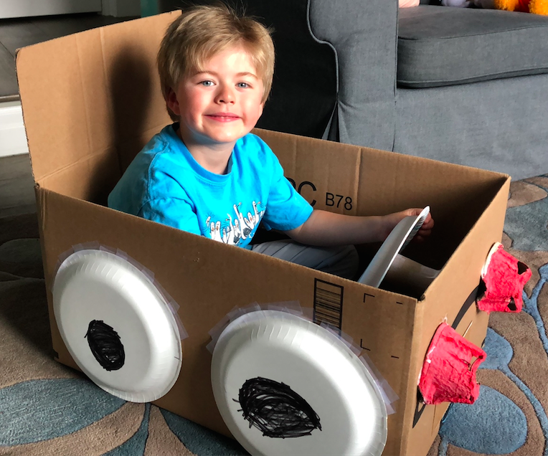
This is my friend from school.
He made a race car! It has fast wheels!

Slide 3
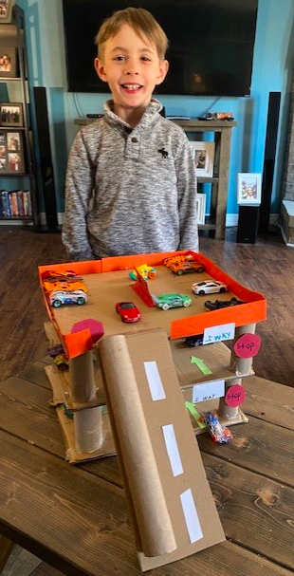
This is my friend from school.
He made a car garage! It has a ramp.

Slide 4
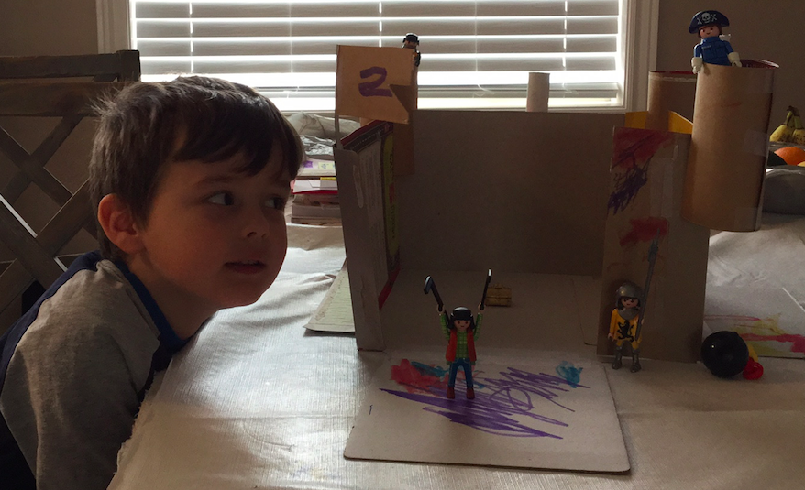
This is my friend from school.
He made a castle! It has a flag.

Slide 5
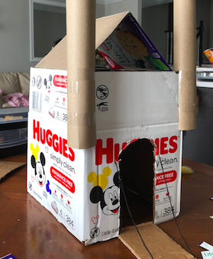
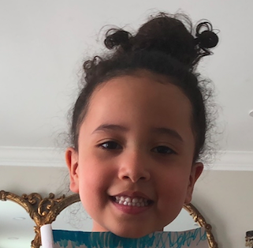
This is my friend from school.
She made a castle! It has a drawbridge.

Slide 6
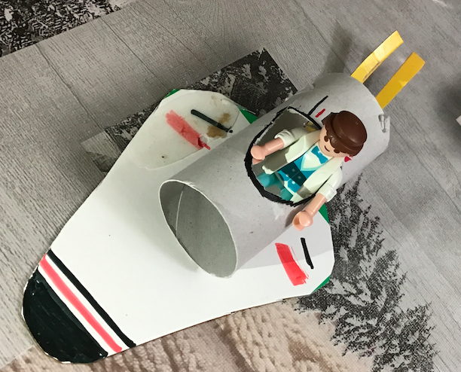
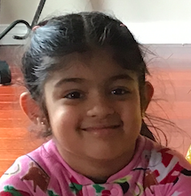
This is my friend from school.
She made a spacecraft! It has wings.

Slide 7
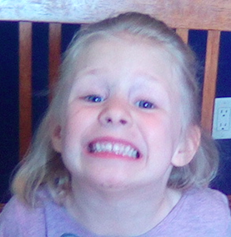
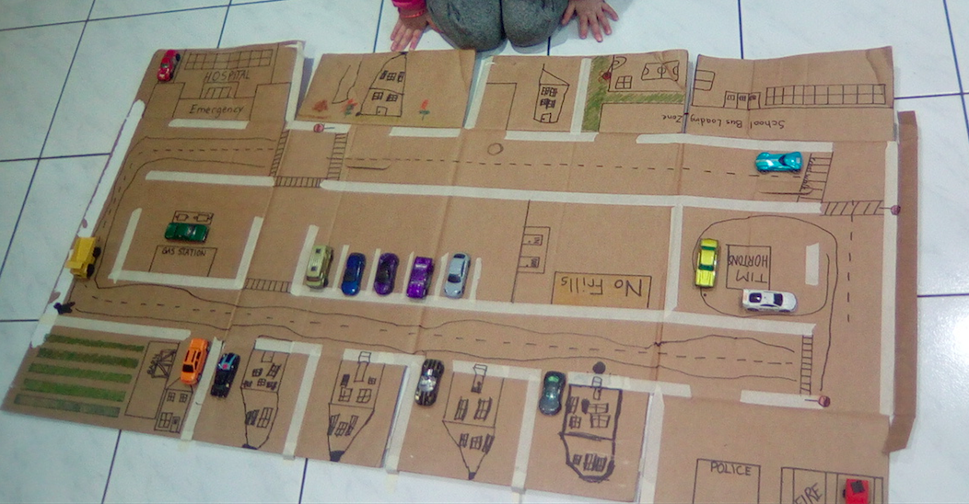
This is my friend from school.
She made a neighbourhood! It has streets.

Slide 8
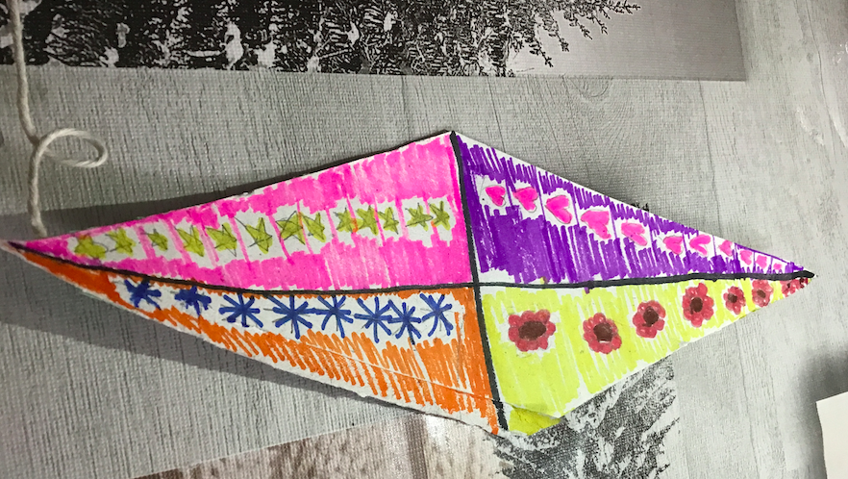
This is my friend from school.
She made a kite! It has four triangles.

Slide 9
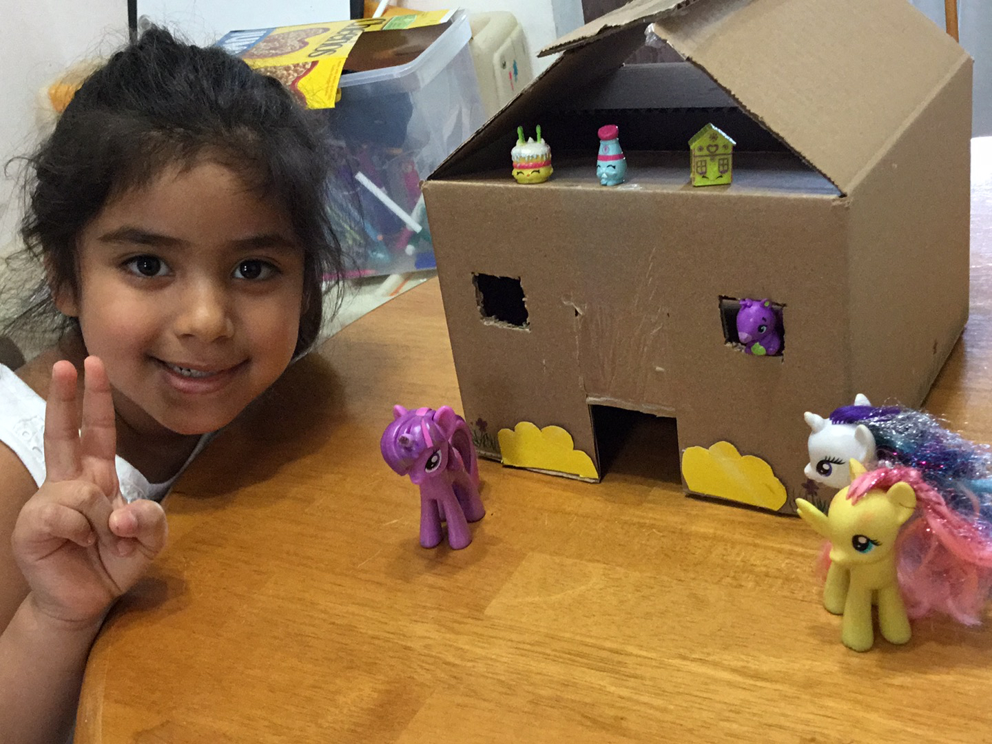
This is my friend from school.
She made a castle! It has a door.

Slide 10
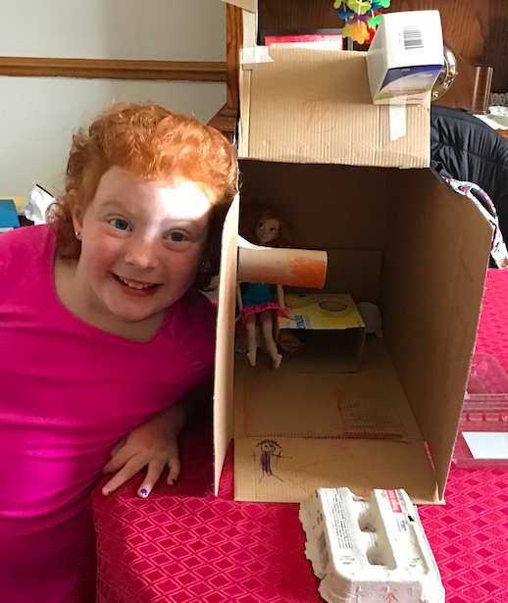
This is my friend from school.
She made a Barbie house! It has a table.

Slide 11
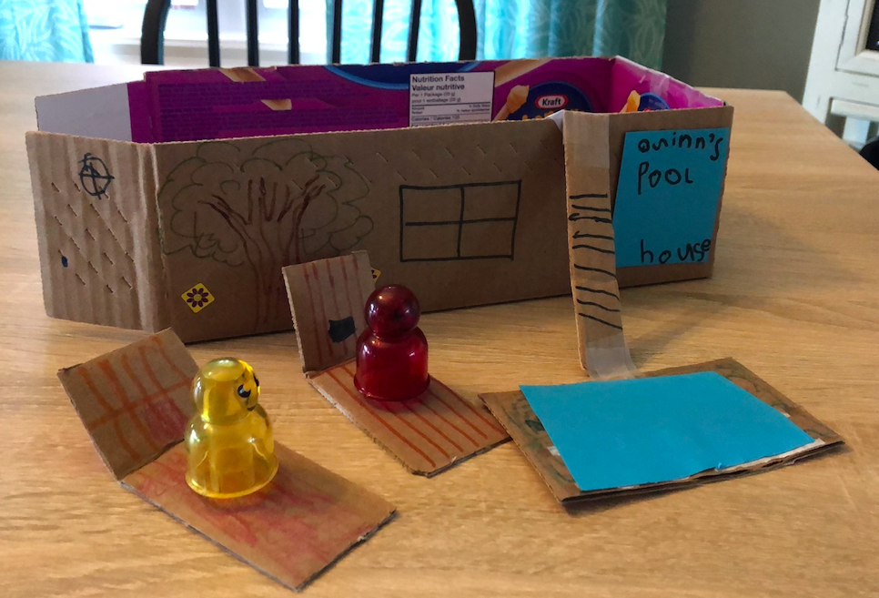
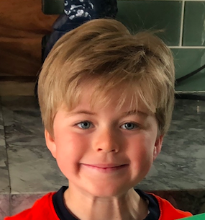
This is my friend from school.
He made a pool house! It has a pool.

Slide 12
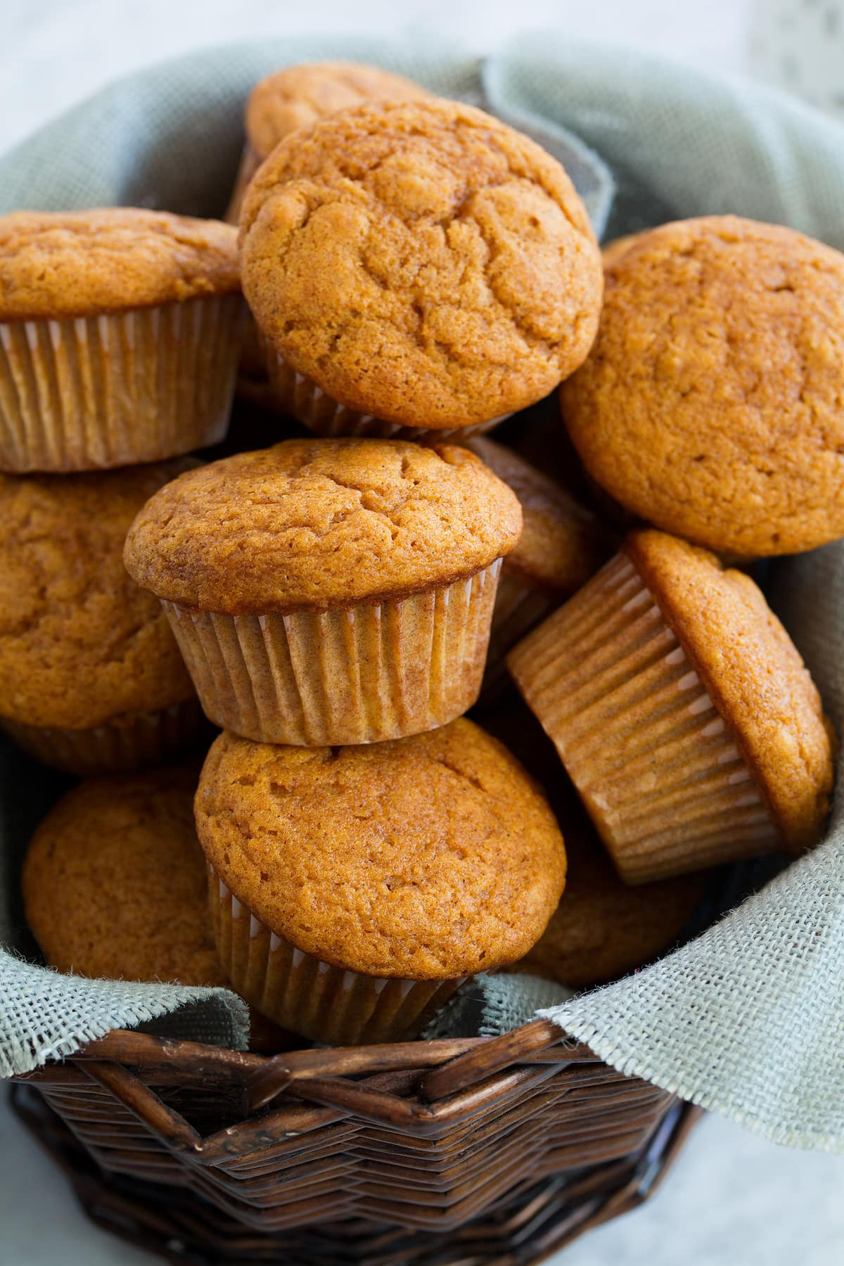
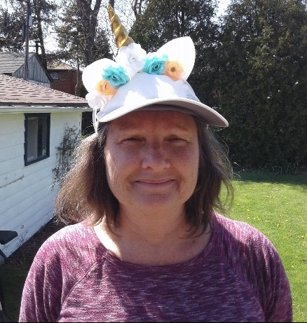
This is Mrs.Jewitt from school.
She made muffins! It is yummy!

Slide 13
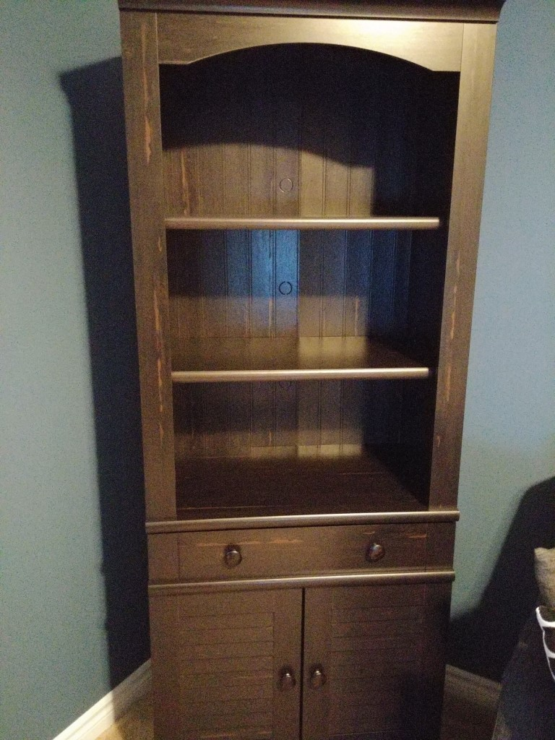
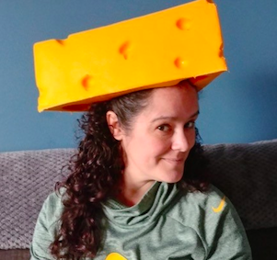
This is Mrs.Amaral from school.
She built a bookshelf! It is brown.

Slide 14
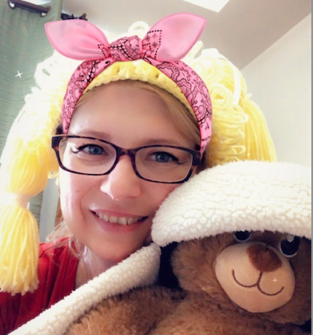
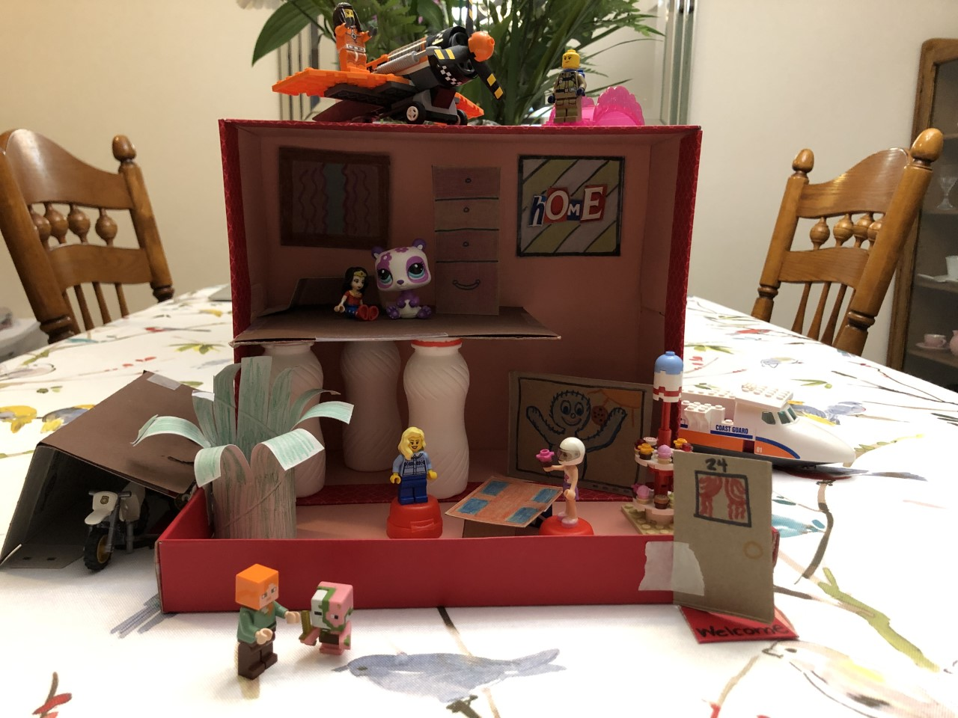
This is Mrs.Benvenga from school.
She made a Hideaway! It has a secret door.

Slide 15
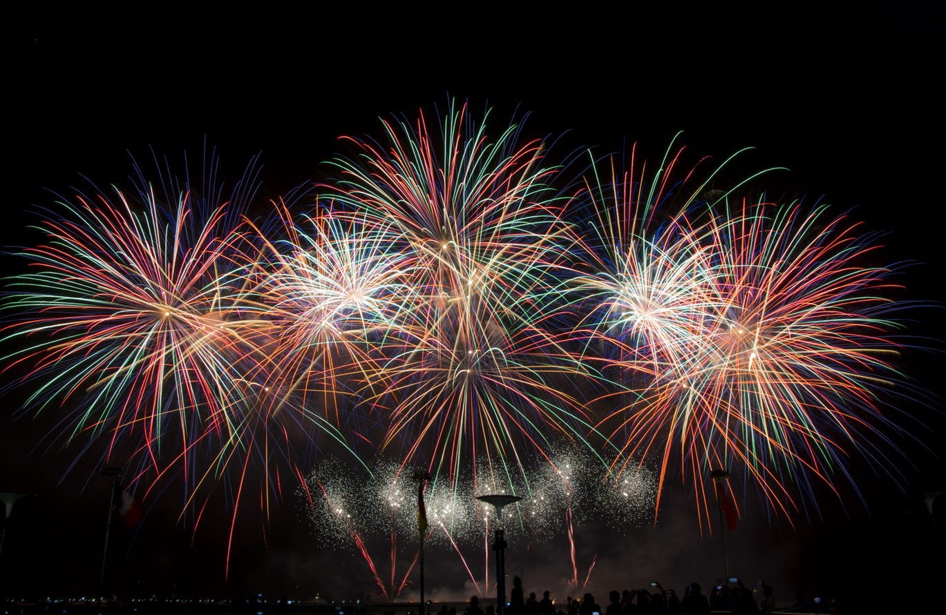
You did SUPER work!
Give yourself a clap and celebrate!

