Slide 1

9. Revisiting Brave Conversations
Module 2 – Understanding Identity & Intersectionality
(Secondary)
BUILDING A COMMUNITY OF CARE

Slide 2

Learning Goal
Students will review the tools and strategies for engaging in brave conversations in a safer environment - in the classroom and in their daily lives.
BUILDING A COMMUNITY OF CARE
Notes:
Brave Space - A brave space is a space where participants feel comfortable learning, sharing, and growing. A brave space is inclusive to all races, sexes, genders, abilities, immigration status, and lived experiences. A “brave space” is where students, teachers and citizens generally can come together to have hard conversations and hear each other out - even and especially when that is challenging.
Brave conversation - In brave conversations, whether in the context of teaching, mentoring, or coaching, individuals are encouraged to express their views openly and truthfully, rather than defensively or with the purpose of laying blame. Integral to brave conversations is an openness to learn.
Safe space/safer space - a place (as on a school campus) intended to be free of bias, conflict, criticism, or potentially threatening actions, ideas, or conversations

Slide 3

Moment to Think...
Discomfort and needs:
How do animals (pets) signal their stress/discomfort? How do they signal their need for necessities, like food, attention, or to go to the washroom?
How does our technology let us know it is not functioning or experiencing difficulties? What are some of the possible cues, prompts, or actions that take place when it needs us to fix an error?
BUILDING A COMMUNITY OF CARE
Notes:
Teacher Note: The connection to make here is that different living things also communicate discomfort to draw attention to their needs. (This can also apply to non-living elements in classrooms that need attention and usually cause students or staff stress/discomfort.)
Brainstorm together or suggest independent thought.

Slide 4



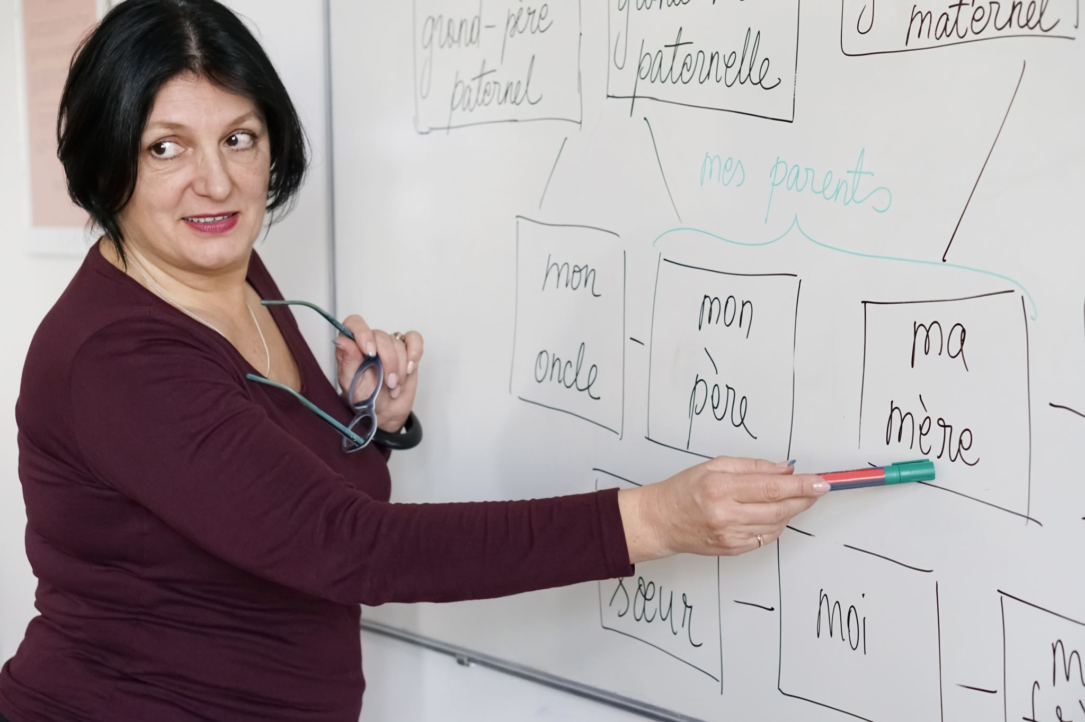
Humans Meeting their Needs
What strategies could you use to advocate for your needs?
As we begin a NEW semester, what communication strategies will you use during remote learning? Need to try something new?
Which caring adults in the school could you speak with for help?
BUILDING A COMMUNITY OF CARE
Notes:
Teacher Prompt: As a Group (Choose a brainstorming or collaborative format that works with your remote learning style). - After contemplating how animals or non-living elements communicate when a need is not met; ask students to collaborate/examine how they advocate for their own needs using the guiding questions above.

Slide 5
Brave Conversations in Safe Spaces
The pandemic is an ongoing health crisis but also a time where many social justice and equity issues have emerged on social media and throughout society. In upcoming lessons, we will be having some brave conversations about some of these issues which might cause some people to feel discomfort.
Therefore, to have these important conversations or disagreements, we need to maintain an environment of mutual respect so that everyone feels safe. To build this safer space to engage in new, uncomfortable, and brave conversations, we need to establish some Guidelines to follow with regards to advocating for our own needs.
BUILDING A COMMUNITY OF CARE
Notes:
NOTES: If a student is upset, angry or silent during/following these conversations, let them know that they can speak with you or email you afterwards for support or direct them to receive the help they may need (i.e., school social worker, settlement workers, We Help Hotline/App, Guidance, Kids Help Phone etc.)
It is important to shut down bias and hate at all levels and in all areas of the school. Here are some examples of statements to shut down harmful comments:
“Those words hurt and anger a lot of people. We do not use them in the classroom.”
“Using that word(s) to put someone down is unacceptable.”
Be aware that some students may express negative attitudes. It is important to allow them to voice their views and they should be probed, but this should be followed by clearly stating that as a community of learners, you do not tolerate offensive and harmful attitudes and promote the importance of respecting each other’s differences. If any remarks are directed towards specific students, then it may be necessary to follow up with the Safe School’s policy.
https://www.hwdsb.on.ca/secondary/supports/safe-schools/

Slide 6

Advocating for Your Needs!
Guideline to have Mutually Respectful Conversations or Disagreements – Advocating for Your Needs
If you need to seek clarity on someone’s statement... | “Tell me more about _____________”
If you would like to offer an alternative perspective in the conversation.... | “Have you ever considered __________.”
To respectfully speak your truth... | “I don’t see it the way you do. I see it as __________.”
To seek common ground... | “We don’t agree on __________ but we can agree on __________.”
To respectfully ask for time and space in a discussion... | “Could we revisit the conversation about __________ tomorrow.”
To respectfully set your boundaries... | “Please do not say __________ again to me or around me.”
BUILDING A COMMUNITY OF CARE
Notes:
You will need to be in full screen mode for students to be able to read the slide. You could also take this chart from the lesson template and project it separately from the slide deck.
Teacher Prompt: After reviewing the provided guideline, tell students you will be post them somewhere permanently and prominently on your HUB page or MS Teams for future reference during discussions.

Slide 7
Co-creating Discussion Rules for Our Class
Actively listen with respect. Try to understand what someone is saying before rushing to judgment.
BUILDING A COMMUNITY OF CARE
Notes:
As a next step to the Guideline, you have an opportunity to be a co-learner with your students. Invite students to collaborate with you to make a set of MS Teams - Rules for Courageous Discussions that supports everyone's needs. (blank slides provided or you can do it in another format that works for you).
A suggested rule to get the ball rolling..... see the rules below for inspiration while co-creating with your students to meet the needs of your class.
Make comments using “I” statements.
If you do not feel safe making a comment or asking a question, write down your thought. You can share the idea with your teacher first and together come up with a safe way to share the idea.
If someone says an idea or question that helps your own learning, say thank you.
If someone says something that hurts or offends you, do not attack the person. Acknowledge that the comment—not the person—hurt your feelings and explain why.
MS Team chat bars are not social media chat bars, proper language for school is required.
Put-downs are never okay.
Social media groups connected to a class, that impact a student in a negative way, are extensions of the virtual classroom (like a hallway or the atrium, school rules still apply).
Derogatory terms/remarks will not be permitted and will result in a student/teacher discussion minimally.
If you do not understand something, ask a question.
Think with your head and your heart.
Share the talking time—provide room for others to speak.
Do not interrupt others while they are speaking.
Write your thoughts down if you do not have time to say them during class.
If at any time you feel upset following a conversation in the classroom, speak with or email your teacher or caring adult in the building so that they can support you or direct you to receive the help you may need (i.e., school social worker, settlement workers, HWDSB Helps Hotline/App, guidance, Kids Help Phone etc.)
Modified from: https://www.facinghistory.org/resource-library/teaching-strategies/contracting

Slide 8
Co-creating Discussion Rules for Our Class
BUILDING A COMMUNITY OF CARE
Notes:
As a next step to the Guideline, you have an opportunity to be a co-learner with your students. Invite students to collaborate with you to make a set of MS Teams - Rules for Courageous Discussions that supports everyone's needs. (blank slides provided or you can do it in another format that works for you).
A suggested rule to get the ball rolling..... see the rules below for inspiration while co-creating with your students to meet the needs of your class.
Make comments using “I” statements.
If you do not feel safe making a comment or asking a question, write down your thought. You can share the idea with your teacher first and together come up with a safe way to share the idea.
If someone says an idea or question that helps your own learning, say thank you.
If someone says something that hurts or offends you, do not attack the person. Acknowledge that the comment—not the person—hurt your feelings and explain why.
MS Team chat bars are not social media chat bars, proper language for school is required.
Put-downs are never okay.
Social media groups connected to a class, that impact a student in a negative way, are extensions of the virtual classroom (like a hallway or the atrium, school rules still apply).
Derogatory terms/remarks will not be permitted and will result in a student/teacher discussion minimally.
If you do not understand something, ask a question.
Think with your head and your heart.
Share the talking time—provide room for others to speak.
Do not interrupt others while they are speaking.
Write your thoughts down if you do not have time to say them during class.
If at any time you feel upset following a conversation in the classroom, speak with or email your teacher or caring adult in the building so that they can support you or direct you to receive the help you may need (i.e., school social worker, settlement workers, HWDSB Helps Hotline/App, guidance, Kids Help Phone etc.)
Modified from: https://www.facinghistory.org/resource-library/teaching-strategies/contracting

Slide 9
Co-creating Discussion Rules for Our Class
BUILDING A COMMUNITY OF CARE
Notes:
As a next step to the Guideline, you have an opportunity to be a co-learner with your students. Invite students to collaborate with you to make a set of MS Teams - Rules for Courageous Discussions that supports everyone's needs. (blank slides provided or you can do it in another format that works for you).
A suggested rule to get the ball rolling..... see the rules below for inspiration while co-creating with your students to meet the needs of your class.
Make comments using “I” statements.
If you do not feel safe making a comment or asking a question, write down your thought. You can share the idea with your teacher first and together come up with a safe way to share the idea.
If someone says an idea or question that helps your own learning, say thank you.
If someone says something that hurts or offends you, do not attack the person. Acknowledge that the comment—not the person—hurt your feelings and explain why.
MS Team chat bars are not social media chat bars, proper language for school is required.
Put-downs are never okay.
Social media groups connected to a class, that impact a student in a negative way, are extensions of the virtual classroom (like a hallway or the atrium, school rules still apply).
Derogatory terms/remarks will not be permitted and will result in a student/teacher discussion minimally.
If you do not understand something, ask a question.
Think with your head and your heart.
Share the talking time—provide room for others to speak.
Do not interrupt others while they are speaking.
Write your thoughts down if you do not have time to say them during class.
If at any time you feel upset following a conversation in the classroom, speak with or email your teacher or caring adult in the building so that they can support you or direct you to receive the help you may need (i.e., school social worker, settlement workers, HWDSB Helps Hotline/App, guidance, Kids Help Phone etc.)
Modified from: https://www.facinghistory.org/resource-library/teaching-strategies/contracting

Slide 10
Co-creating Discussion Rules for Our Class
BUILDING A COMMUNITY OF CARE
Notes:
As a next step to the Guideline, you have an opportunity to be a co-learner with your students. Invite students to collaborate with you to make a set of MS Teams - Rules for Courageous Discussions that supports everyone's needs. (blank slides provided or you can do it in another format that works for you).
A suggested rule to get the ball rolling..... see the rules below for inspiration while co-creating with your students to meet the needs of your class.
Make comments using “I” statements.
If you do not feel safe making a comment or asking a question, write down your thought. You can share the idea with your teacher first and together come up with a safe way to share the idea.
If someone says an idea or question that helps your own learning, say thank you.
If someone says something that hurts or offends you, do not attack the person. Acknowledge that the comment—not the person—hurt your feelings and explain why.
MS Team chat bars are not social media chat bars, proper language for school is required.
Put-downs are never okay.
Social media groups connected to a class, that impact a student in a negative way, are extensions of the virtual classroom (like a hallway or the atrium, school rules still apply).
Derogatory terms/remarks will not be permitted and will result in a student/teacher discussion minimally.
If you do not understand something, ask a question.
Think with your head and your heart.
Share the talking time—provide room for others to speak.
Do not interrupt others while they are speaking.
Write your thoughts down if you do not have time to say them during class.
If at any time you feel upset following a conversation in the classroom, speak with or email your teacher or caring adult in the building so that they can support you or direct you to receive the help you may need (i.e., school social worker, settlement workers, HWDSB Helps Hotline/App, guidance, Kids Help Phone etc.)
Modified from: https://www.facinghistory.org/resource-library/teaching-strategies/contracting

Slide 11

Brave & Safe Conversations...RECAP
Will I be an attentive listener?
Will I express any disagreement in a respectful way?
Will I feel safer with co-created rules in place?
Was I a safe collaborator today?
Am I capable of having brave conversations or do I need to talk with my teacher?
BUILDING A COMMUNITY OF CARE
Notes:
Educator post reflection:
Was the classroom environment a safe or brave space (today)? What are some next steps to help students continue to have courageous conversations beyond this learning task?
Where will the “Guidelines to Mutually Respectful Conversations” and the Co-created Rules be uploaded to be accessible for students (The Hub/ MS Teams)?

