Slide 1

8. Ongoing Self-Care
Module 2 – Understanding Identity & Intersectionality
(Secondary)
BUILDING A COMMUNITY OF CARE

Slide 2

Learning Goal
To learn and understand that physical, emotional, mental, and spiritual wellbeing are essential to productivity and that wellbeing starts with our ongoing or daily self-care.
BUILDING A COMMUNITY OF CARE
Notes:
Be mindful and aware that some of your students might be undergoing significant stress or anxiety and will not want to share anything during this lesson. You might be the only person that provides an example and that is ok. Encourage students to practice this on their own time. It is merely one tool or strategy to help them develop or maintain a healthy and positive frame of mind during isolation from school, friends, family, and society. This is not intended to be medical advice, but one strategy of many out there to help with well-being, resilience, and self-care.

Slide 3

Moment to Think...
The term Self-Care has been used a lot since the beginning of COVID-19 and how it is important to your overall wellbeing.
What does the term Self-Care mean?
Why is it important?
Do you know any self-care strategies?
Think or jot down some ideas to answer these 3 questions.
BUILDING A COMMUNITY OF CARE
Notes:
The following slides are meant to be references for understanding self-care and the importance overall wellbeing. They are a lead up to the Task at the end of this lesson.

Slide 4

Self-Care
Taking care of your mental, emotional, and physical health is key to your overall well-being (“Self-Care Checklist - Kids Help Phone”). It is important to take time out of your daily life to focus on YOU and your mental, emotional, and physical well-being. The Ongoing Self-Care Check-In Task coming up, will allow you to reflect on your own personal needs and learn to reach out for support in times of unproductivity, isolation, or stress.
BUILDING A COMMUNITY OF CARE
Notes:
Providing context, definitions, reflections, actions, activities for self-care in general and the four types of self-care or wellbeing that will be covered in the Ongoing Self-Care Check-In Task.
Link provided for a Self-Care Checklist from Kids Help Phone.

Slide 5
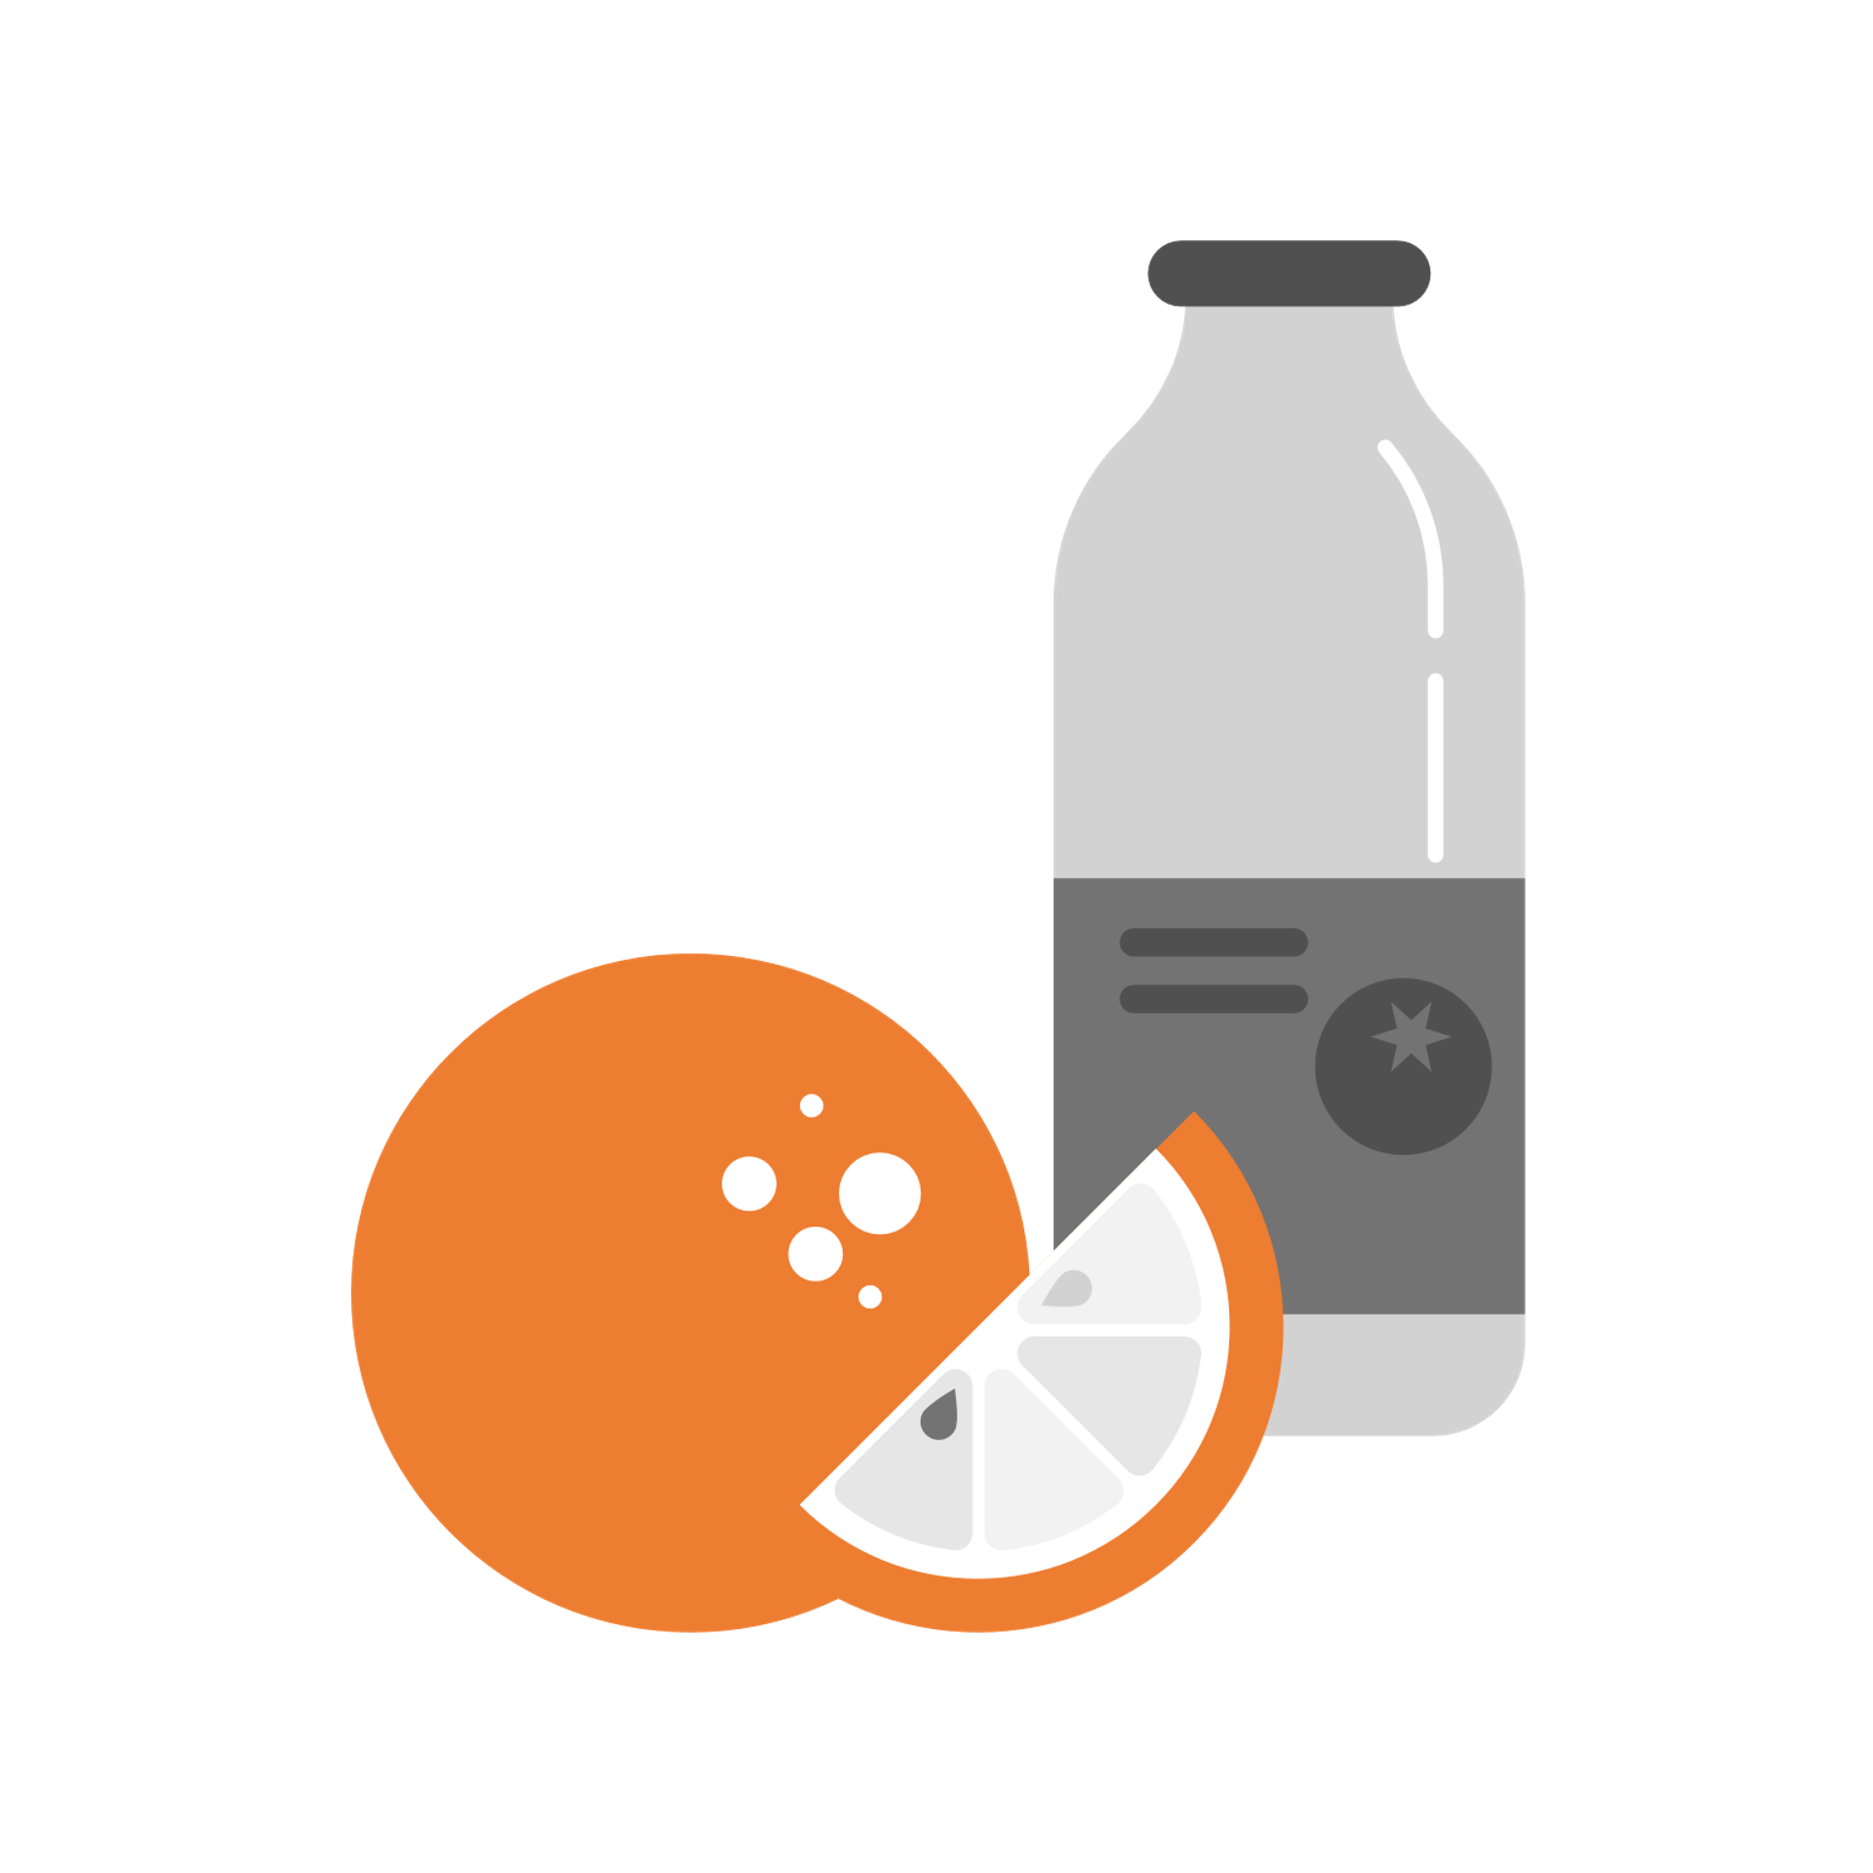
What is Physical Wellbeing?
Taking care of your daily/basic biological or physical needs. Ongoing maintenance of your body’s physical health.
BUILDING A COMMUNITY OF CARE
Notes:
*Before advancing to the Possibilities slide with each area of wellbeing – brainstorm some ideas together, then provide the examples on the next slide for reference to complete the upcoming Task.

Slide 6

Possibilities of actions or activities that will keep my body healthy:
Sleep (7 to 8 hours), Shower/Wash, Brush teeth,
Exercise, Stretch/Yoga, Eat healthy foods, Drink water, etc....
Can you think of any others?
BUILDING A COMMUNITY OF CARE

Slide 7

What is Mental Wellbeing?
Taking care of your psychological or mental health needs. Ongoing maintenance of your brain's overall health and functionality.
BUILDING A COMMUNITY OF CARE
Notes:
*Before advancing to the Possibilities slide with each area of wellbeing – brainstorm some ideas together, then provide the examples on the next slide for reference to complete the upcoming Task.

Slide 8


Possibilities of thoughts, reflections, actions, or activities that will keep my mind healthy:
Talking to others (connection), Deep breathing, Music,
Personal reflection, Writing, Leaning on your support network, etc.
BUILDING A COMMUNITY OF CARE

Slide 9


What is Emotional Wellbeing?
Being mindful of your emotions and not ignoring them. Naming your feelings and expressing them in an appropriate way. Asking for help when feeling overwhelmed, unsettled, or stressed. Taking time to celebrate and express positive emotions and feelings throughout your day.
BUILDING A COMMUNITY OF CARE
Notes:
*Before advancing to the Possibilities slide with each area of wellbeing – brainstorm some ideas together, then provide the examples on the next slide for reference to complete the upcoming Task.

Slide 10


Possibilities of reflections, actions, or activities that will make me feel calmer or supported.
Reflecting on my emotions, talking to someone I trust, sharing something good that happened today, etc.
BUILDING A COMMUNITY OF CARE

Slide 11



What is Spiritual Wellbeing?
Taking care of your Spirit or Spirituality. Doing or reflection that makes you feel whole, calm, balanced or replenishes your energy or nourishes your core.
BUILDING A COMMUNITY OF CARE
Notes:
*Before advancing to the Possibilities slide with each area of wellbeing – brainstorm some ideas together, then provide the examples on the next slide for reference to complete the upcoming Task.

Slide 12

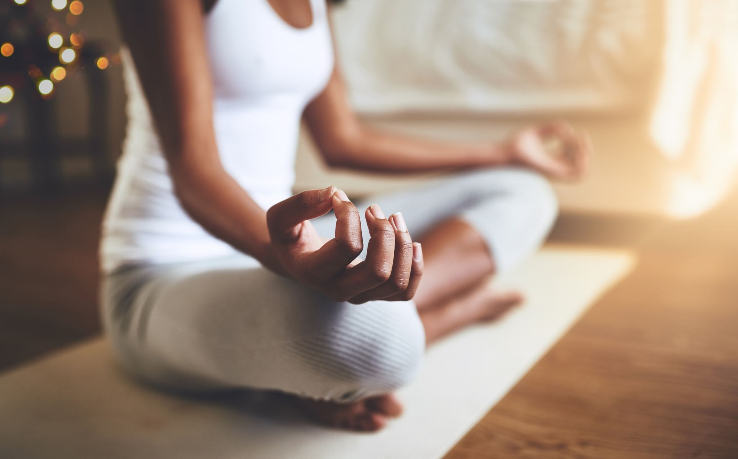



Possibilities of what spiritual or spirit activities and thoughts could mean to me.
Reading a Religious teaching/text, being in nature,
human connection, meditation, doing something for someone else, etc.
BUILDING A COMMUNITY OF CARE

Slide 13
TASK: Ongoing Self-Care Check-In
For each of the 4 types of Wellbeing – Physical, Mental, Emotional, and Spiritual jot down as many activities/ actions that you use already for ongoing Self-Care. Your 4 lists or a mind map should reflect how you recharge your batteries in order to function, feel healthy, or be productive. These activities/actions might take place daily, weekly, or monthly.
BUILDING A COMMUNITY OF CARE
Notes:
Be mindful and aware that some of your students might be undergoing significant stress or anxiety and will not want to share anything during this lesson. You might be the only person that provides an example and that is ok. Encourage students to practice this on their own time. It is merely one tool or strategy to help them develop or maintain a healthy and positive frame of mind during isolation from school, friends, family, and society. This is not intended to be medical advice, but one strategy of many out there to help with well-being, resilience, and self-care.

Slide 14
TASK: Ongoing Self-Care Check-In
When your lists or mind map are complete note which areas of your wellbeing are being maintained through your ongoing self-care activities/actions and which areas could use some attention to improve your overall wellbeing. Do you have a support network of caring adults, family, and friends? Who are they? Make a list, so when you are low/stressed, you do not have to think about who you could talk to.
BUILDING A COMMUNITY OF CARE
Notes:
REMIND STUDENTS: Maintaining your Ongoing Self-Care Check-In.
Continue to try and add new activities or actions to your Ongoing Self-Care Check-In that satisfies or meets your wellbeing and productivity needs. Likewise, eliminate activities that are not fun and do not feel like they recharge you (they feel like work or another task to complete in your day). Self-Care is about creating a resilient, healthy, supported, and productive life. It is an ongoing reflective process.

Slide 15
Recap: Ongoing Self-Care
Daily self-care of my body, mind, emotions, and spirit are essential to my overall well-being and productivity.
My Ongoing Self-Care Check-In is a tool that I might choose to continue to use as needed to support my self-care and does not replace medical advice from a professional.
BUILDING A COMMUNITY OF CARE
Notes:
Educator Post-Reflection...
Did my students feel safe and supported in this very personal activity?
What colleagues can I turn to if some of my students were struggling or in distress with this activity?

Slide 16


Self-Care Quiz…
Am I practicing enough Self-Care?
BUILDING A COMMUNITY OF CARE
Notes:
Have the students use the link to the Kids Help Phone Quiz so they can privately assess their own self-care. (Time Permitting)
The puzzle piece is meant to symbolize the importance of keeping all the parts of ourselves together for our overall wellbeing.

