Slide 1
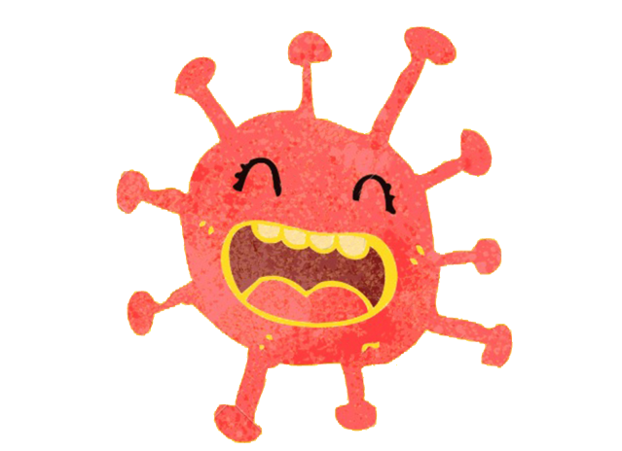
HELLO!
I am a VIRUS, cousins with the common flu.
My name is Coronavirus
MANUELA MOLINA - @MINDHEART.KIDS WWW.MINDHEART.CO
CC BY-NC-SA 4.0 INTERNATIONAL PUBLIC LICENSE

Slide 2
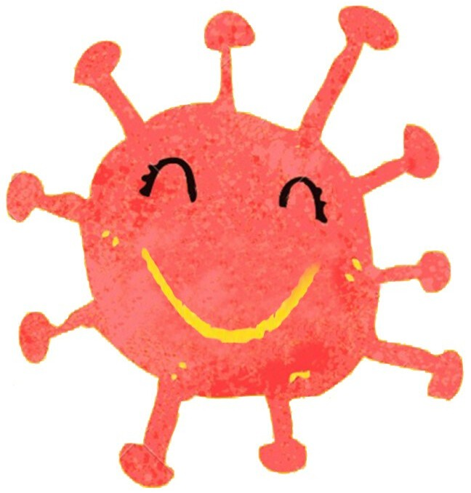

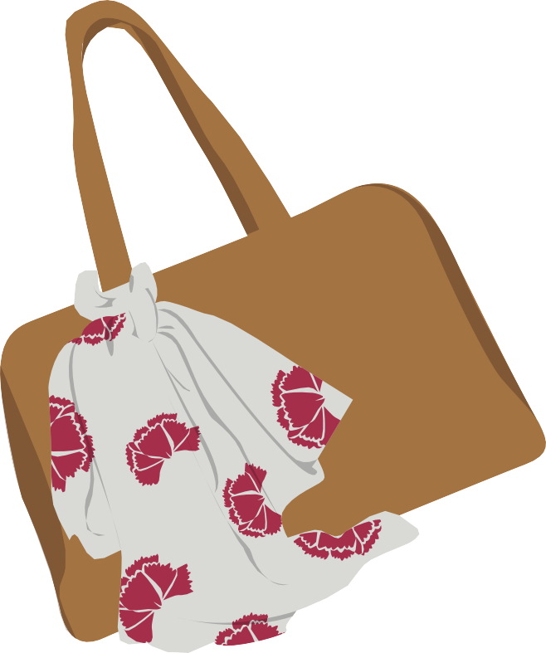
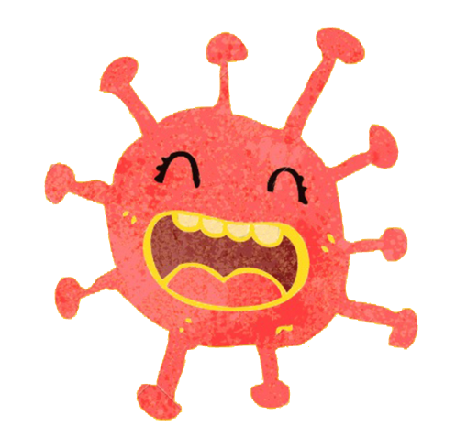
I love to travel...
and to jump
HIGH FIVE
from hand to hand to say Hi

Slide 3






Have you heard about me?
Drag the large arrows to answer each question
YES NO
And how do you feel when you hear my name?
Relaxed
Confused
Worried
Curious
Nervous
Sad

Slide 4
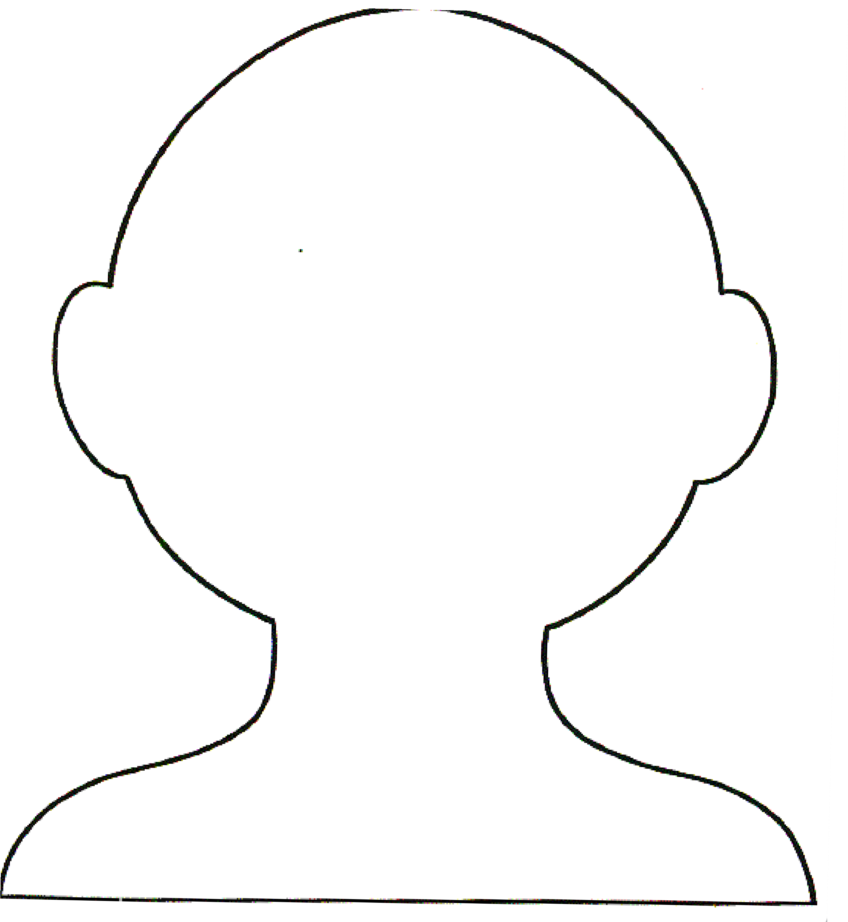
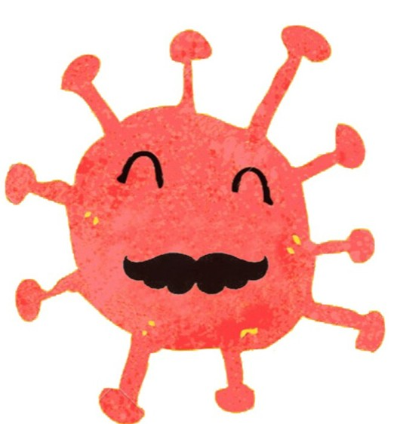
I can understand you feel...
Explain why you feel this way here
I
Explain why you feel this way
Draw it here
...I would feel the same way

Slide 5
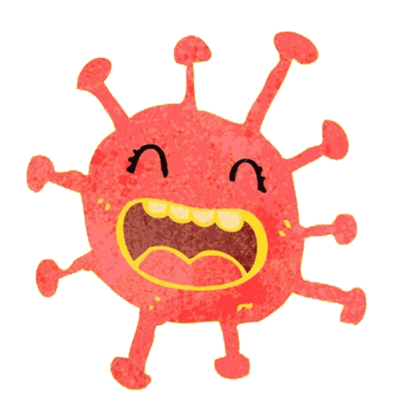

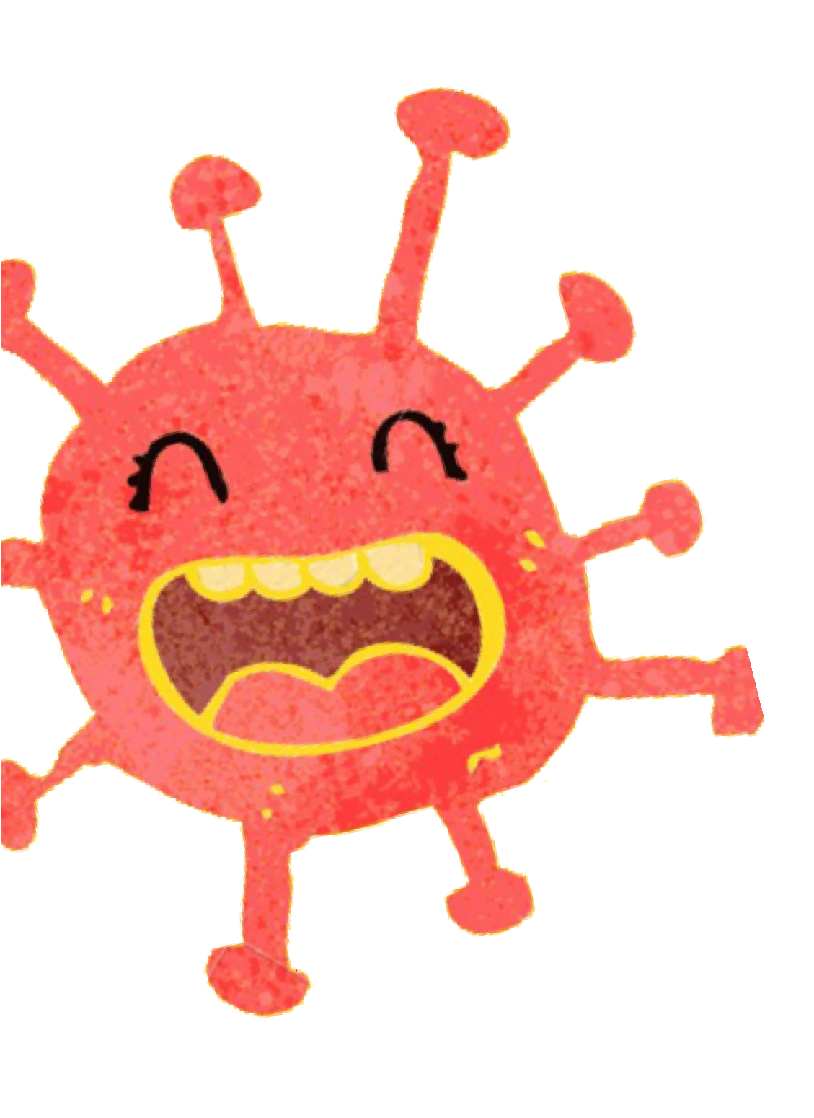




Sometimes adults get worried when they read the news or see me on TV
THAT'S ME!

Slide 6
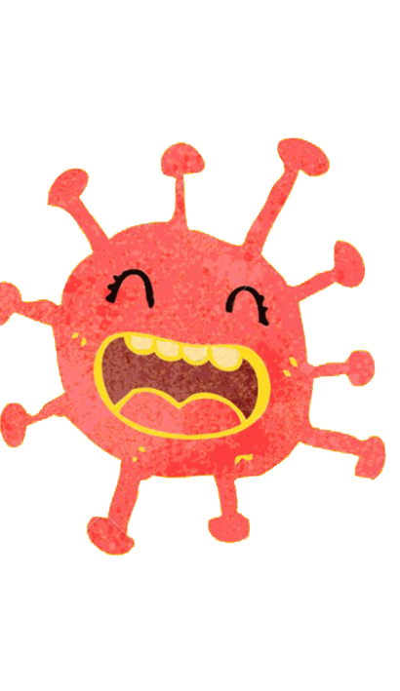
But I am going to explain myself...
COVID-19
So you can understand...

Slide 7

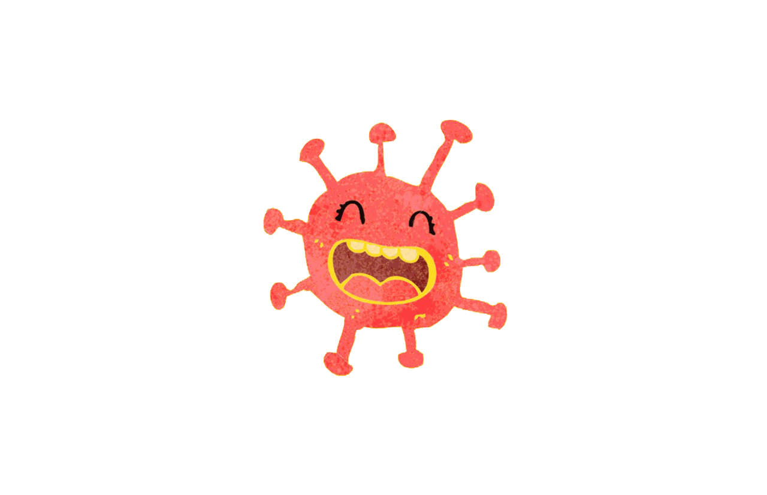

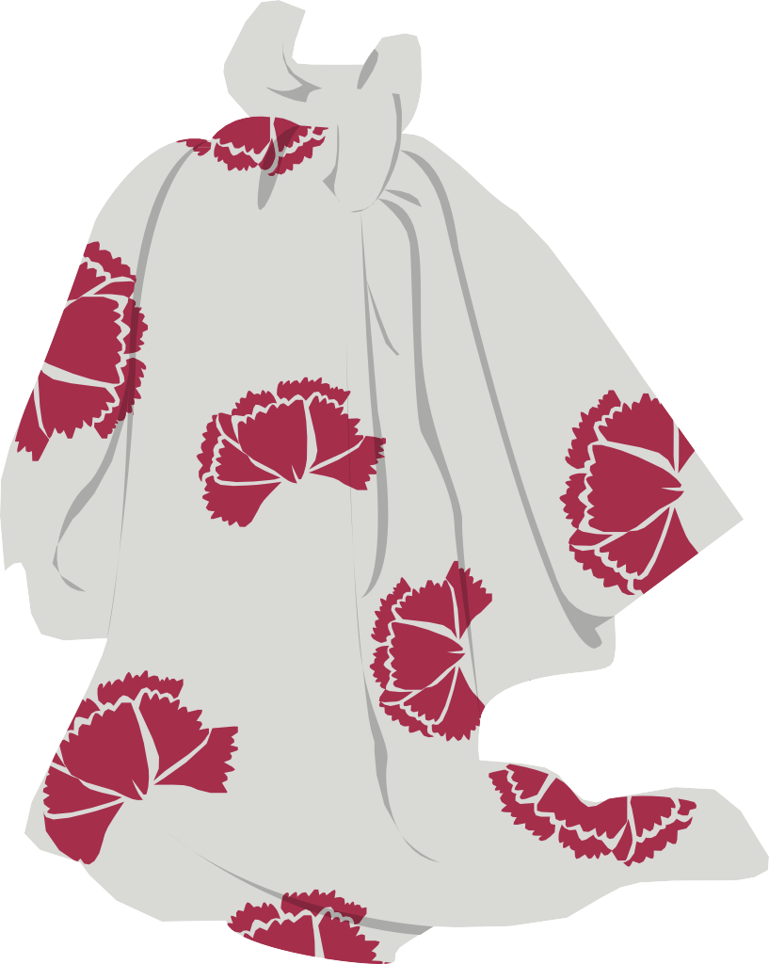
When I come to visit, I bring...
Difficulty breathing
Fever
Cough

Slide 8
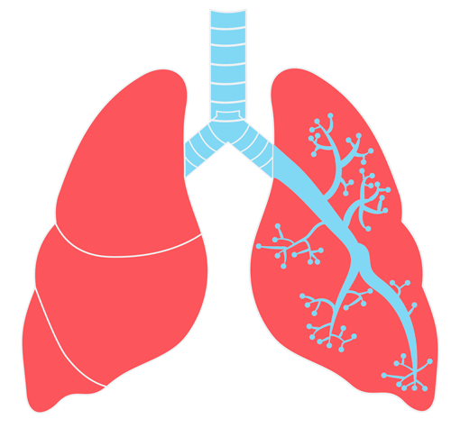
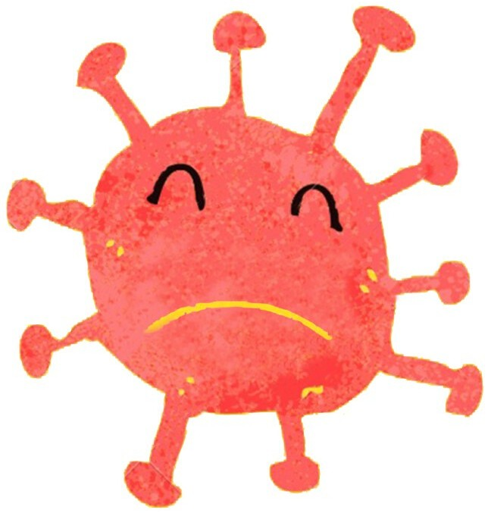
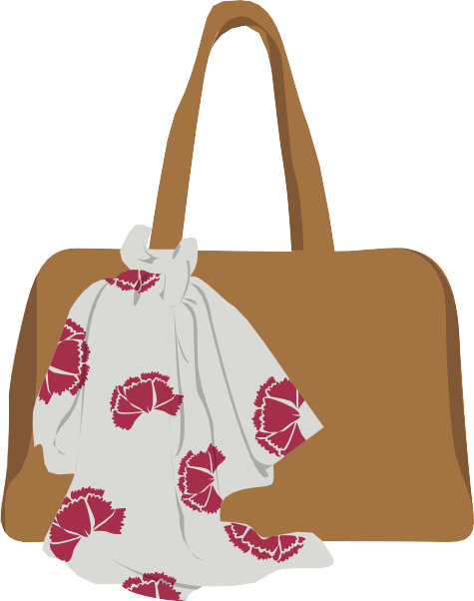
But I don’t stay with people for long, and almost everyone gets better
Just like when you get a scrape on your
knee and it heals
BYE BYE...

Slide 9
The adults who take care of you:
Don't you worry!
Write down the adults here:
will keep you safe

Slide 10

And you can help...
By washing your hands with soap and water while singing a song
You can sing your favorite song, the happy birthday song, or the alphabet song
By using hand sanitizer and letting it dry on your hands
Without moving them count to 10
1, 2, 3, 4, 5, 6, 7, 8, 9, 10
Once your hands are dry you can get back to playing!!

Slide 11
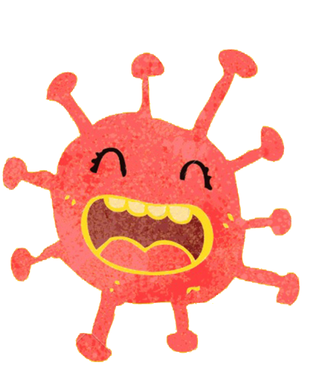

If you do all that
I will not come to visit
while the doctors work to find a vaccine that will allow me to say hi
without getting you sick.
MANUELA MOLINA - @MINDHEART.KIDS WWW.MINDHEART.CO
CC BY-NC-SA 4.0 INTERNATIONAL PUBLIC LICENSE

Slide 12
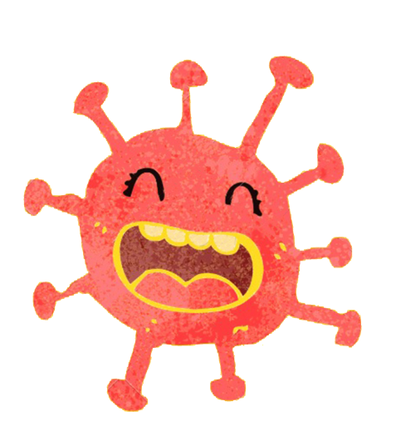
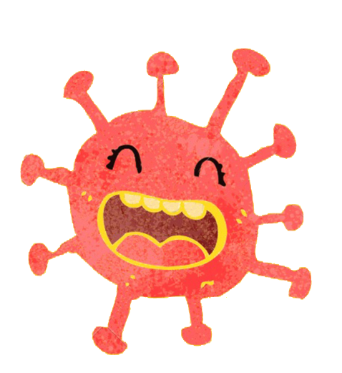


THE End
Questions on the Last Page!
COVibook
Download this PDF here:
www.mindheart.co/descargables
Author:
Manuela Molina Cruz Instagram: @mindheart.kids manuela_825@hotmail.com
CC BY-NC-SA 4.0 International Public License

Slide 13
Follow up Questions!
Question #1: What are some of things you miss most about school? Explain!
I
Question #2: RESEARCH. Where did Covid 19 come from? What city? What country?
I
Question #3: What movies and tv shows have you been watching at home? What movie/show has been your favourite?
Question #4: What has been the biggest challenge for you during social distancing?
DONE! Save file with your answers and send to Mr. Minich: sminich@hwdsb.on.ca

