Slide 1
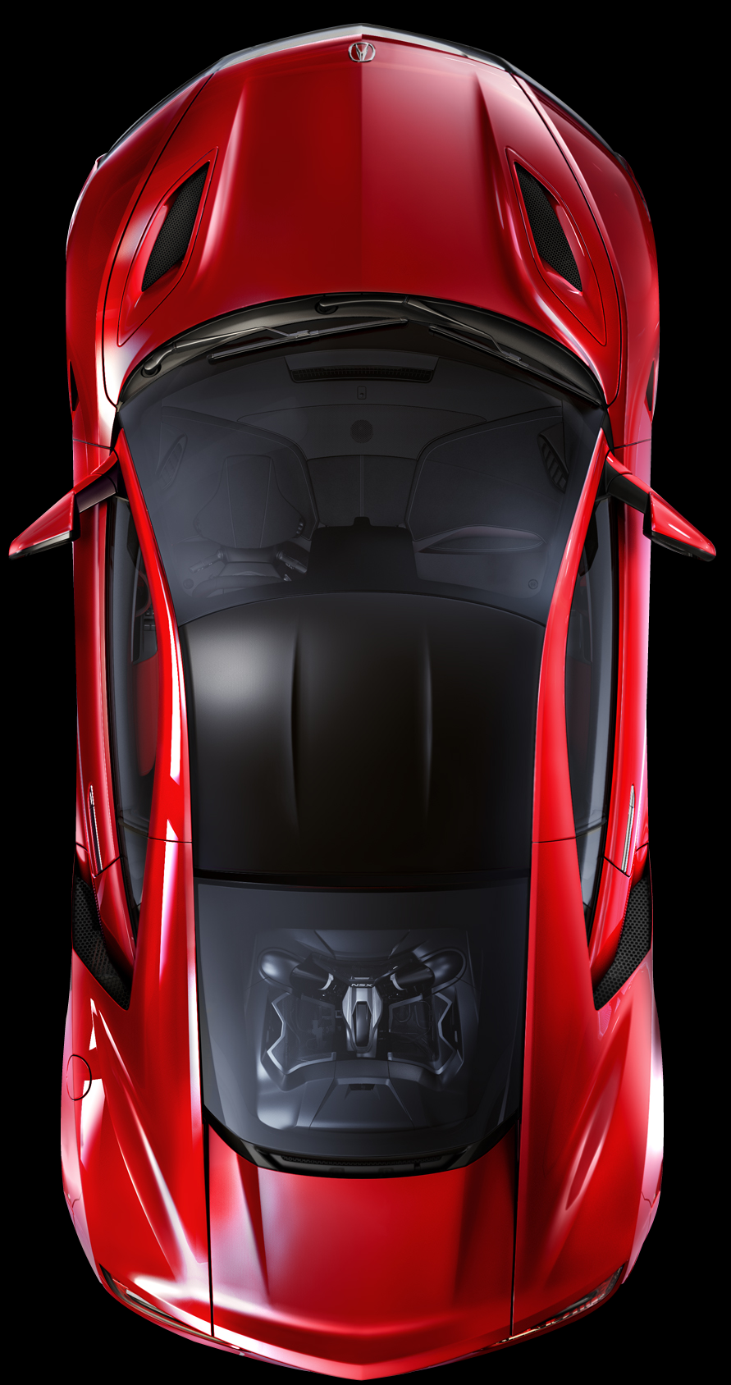
What number is the spot that the car is parked in?
91
90
89
88
86

Slide 3
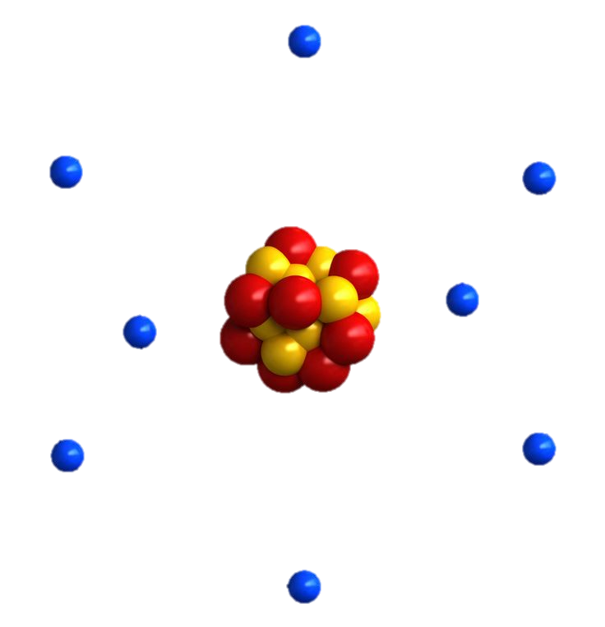
Particle Theory of Matter

Slide 4
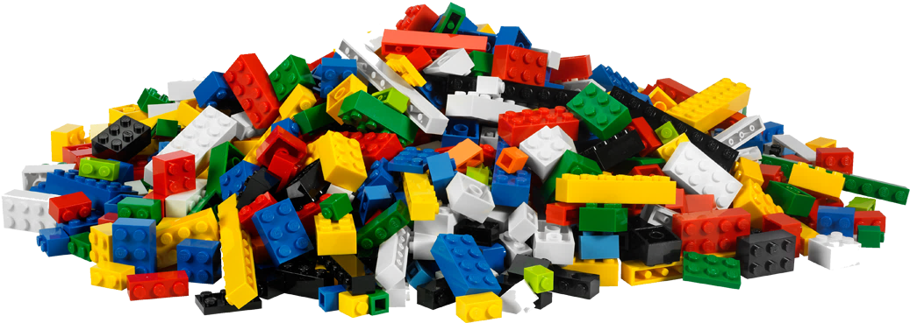

Slide 5
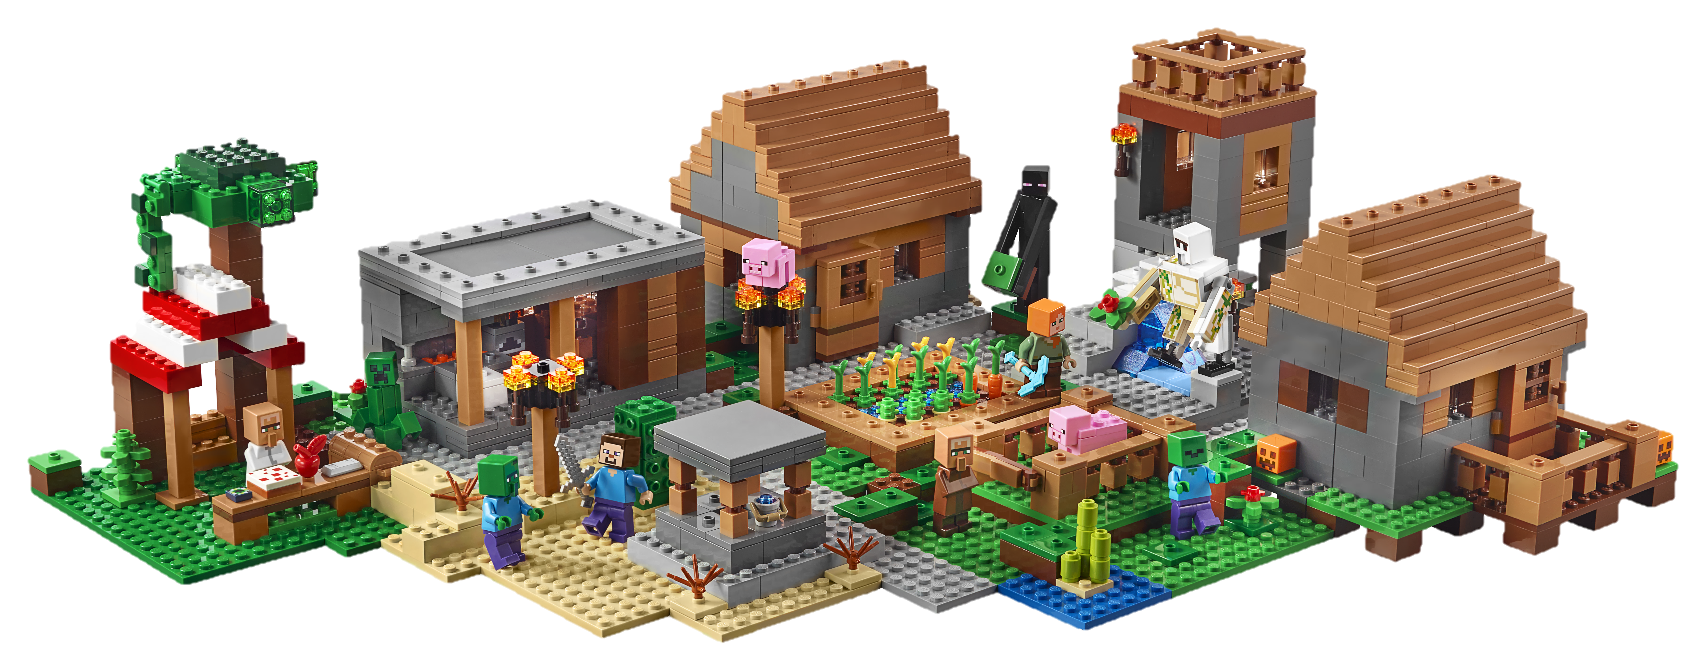


Slide 6
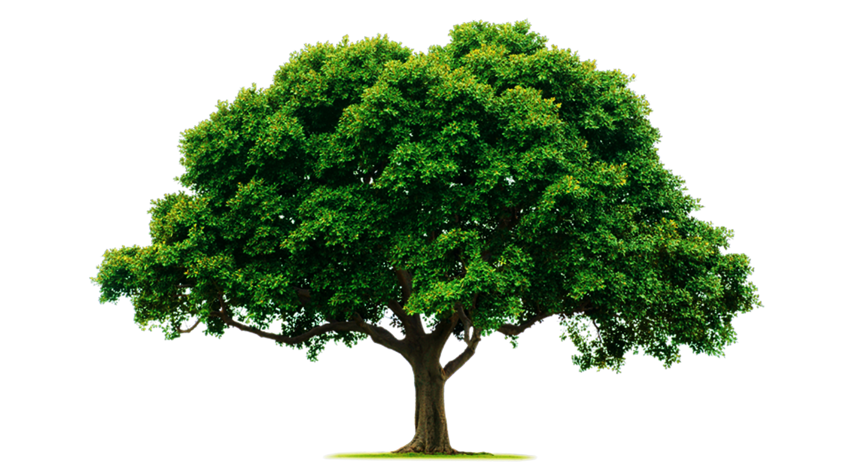


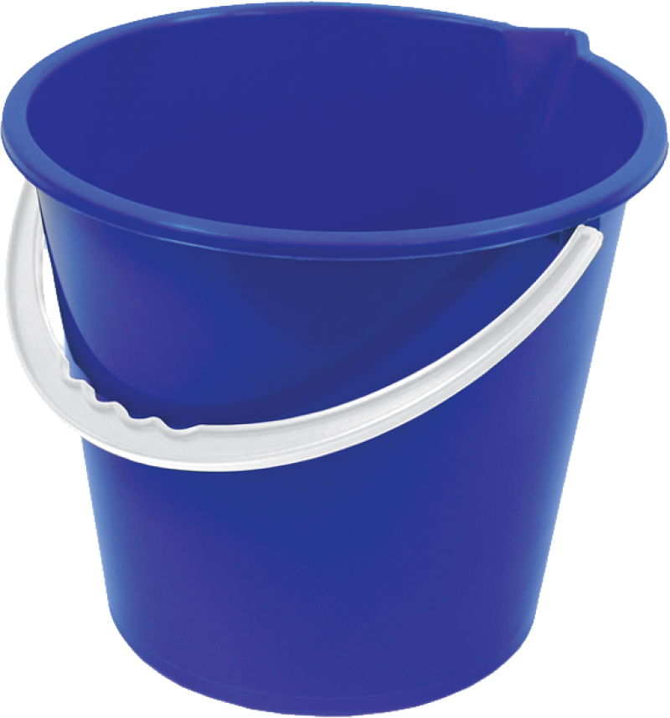

Slide 7
Particle Theory of Matter
All matter is made of tiny particles
Particles have empty spaces between them
Particles are moving randomly all the time
Particles move faster and spread farther apart when they are heated
Particles attract each other

Slide 9
States of Matter

Slide 10
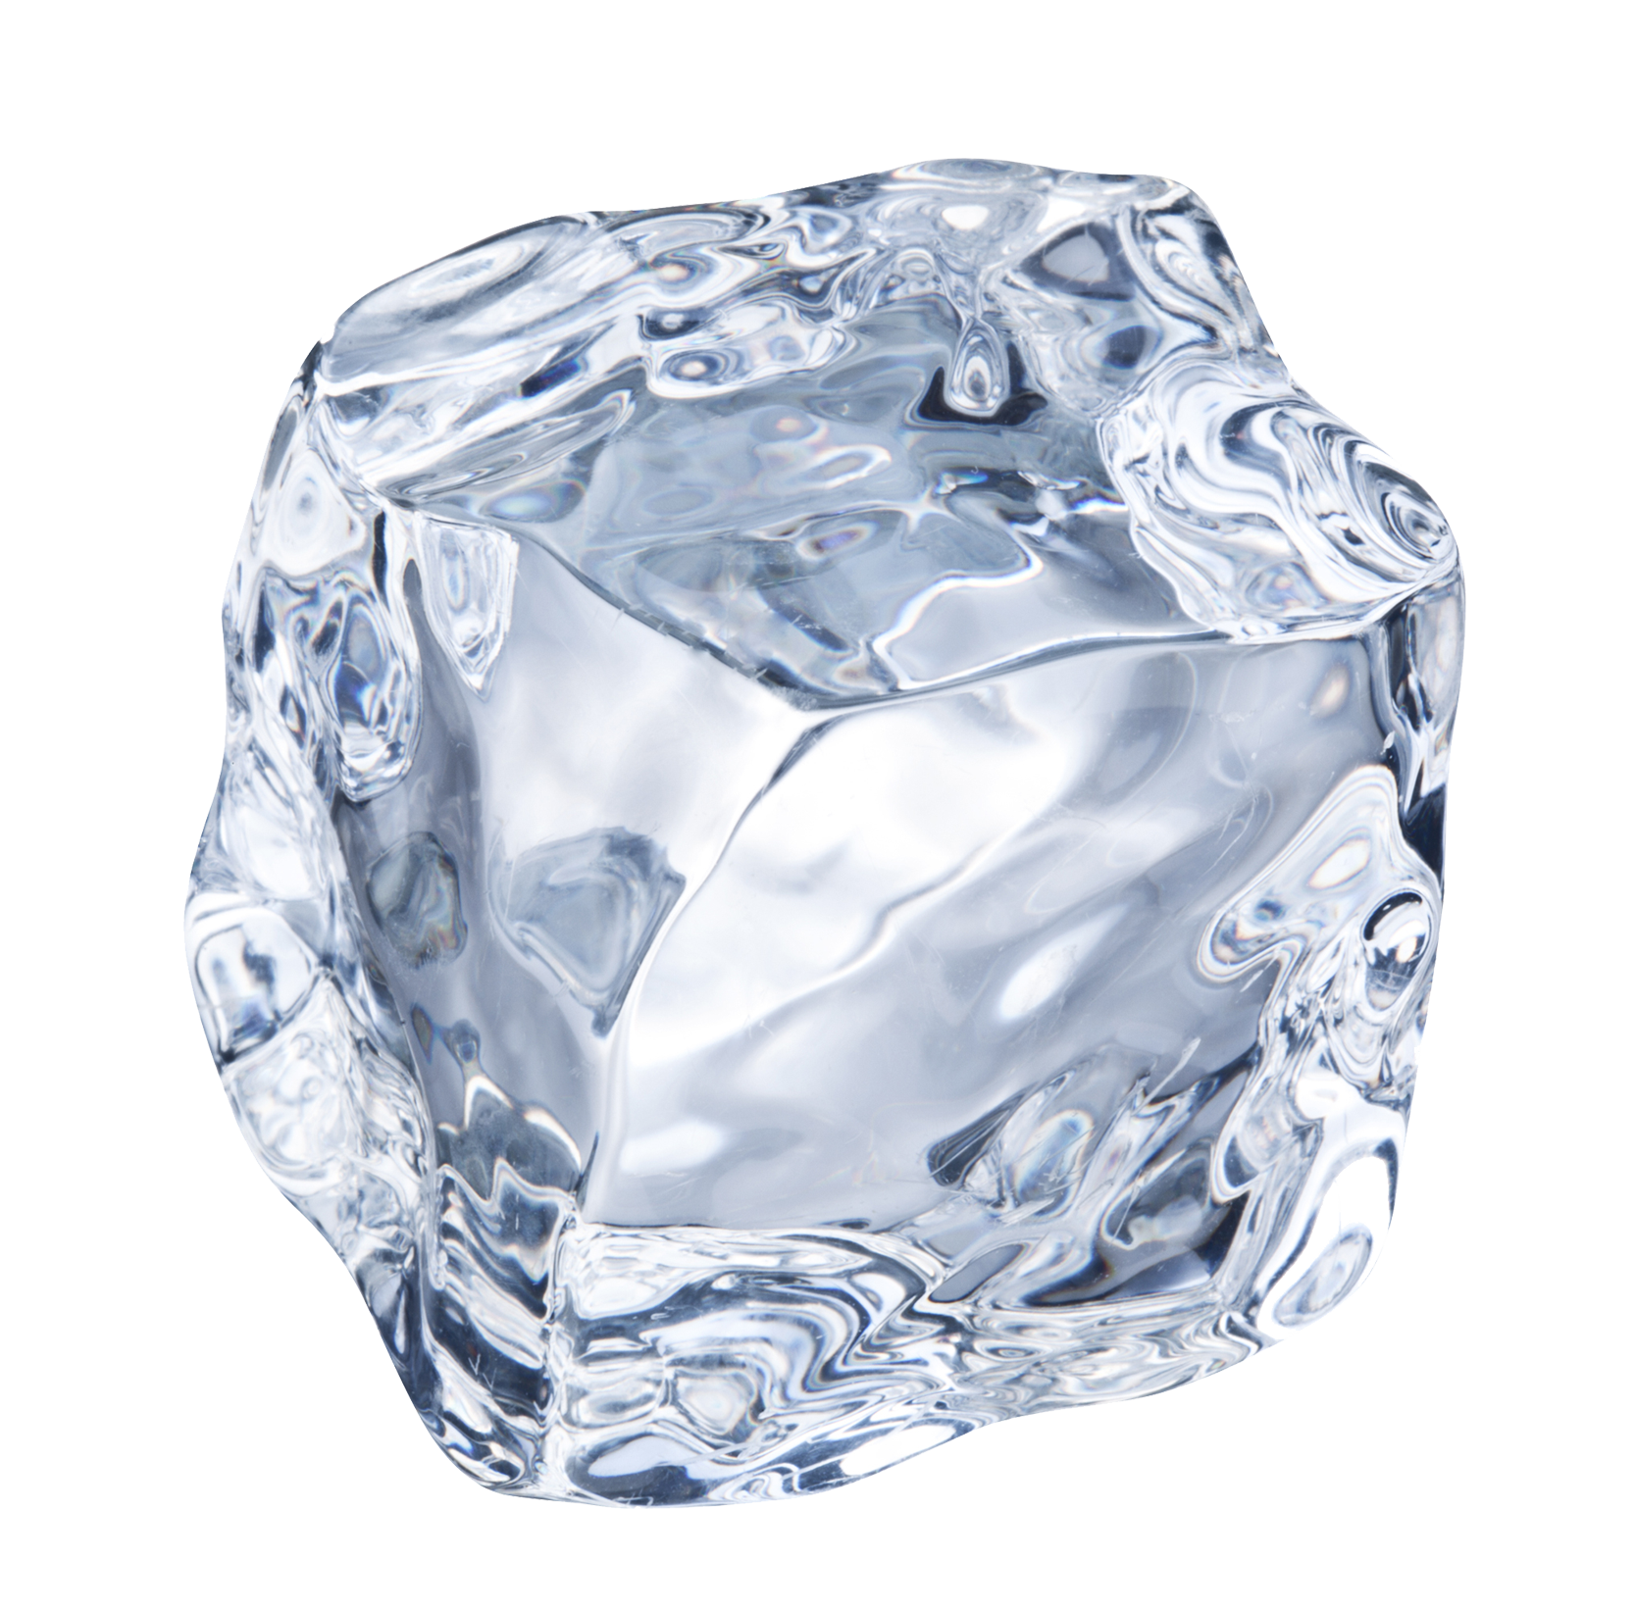
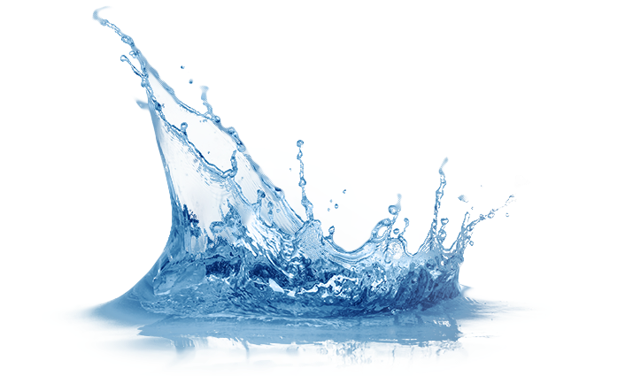
States of Matter
The three primary states of matter are solid, liquid, and gas.

Slide 11

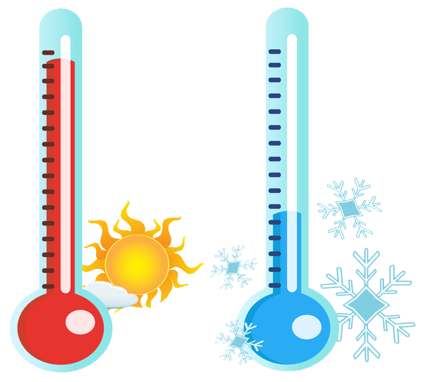
States of Matter
The three primary states of matter are solid, liquid, and gas.

Slide 17
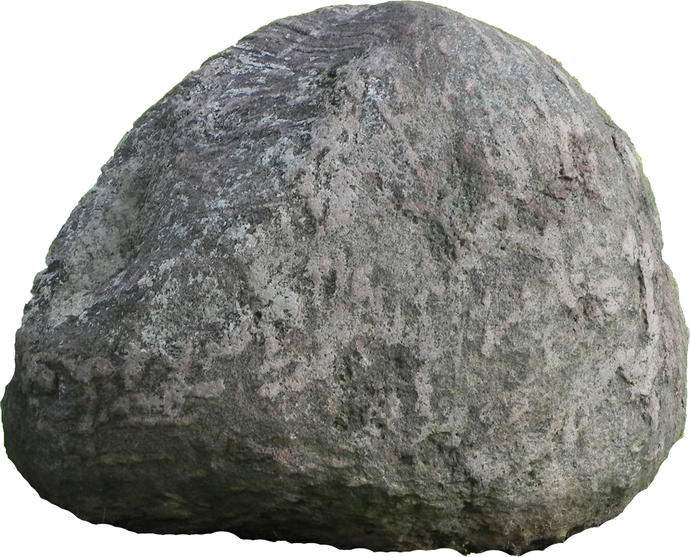
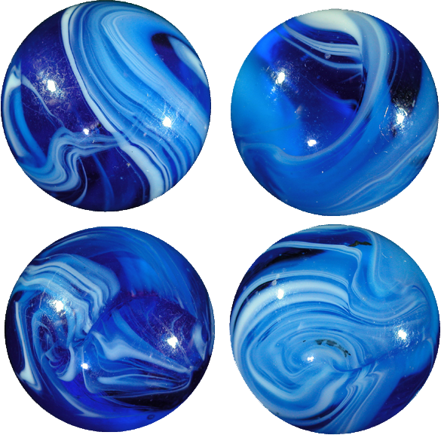
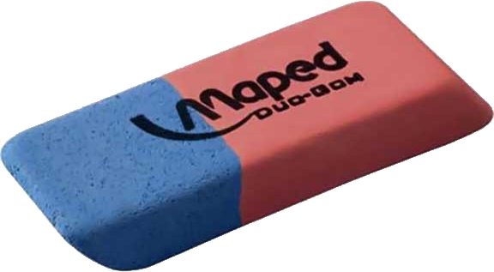

Slide 19



Slide 20
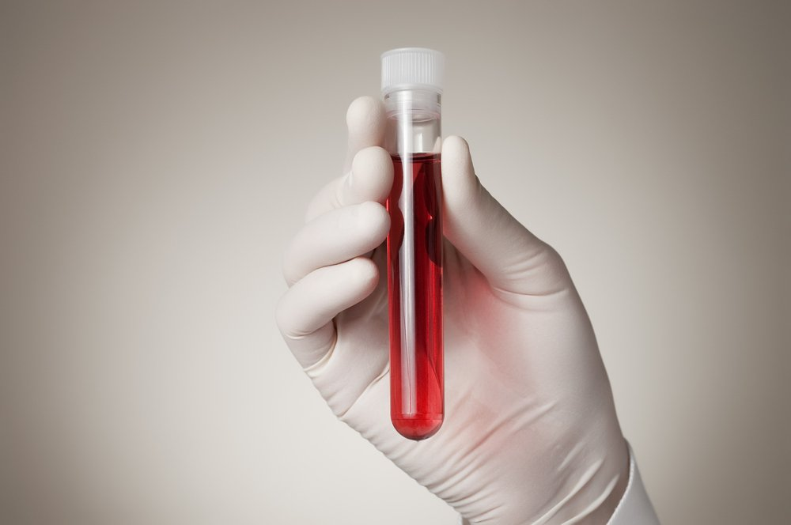
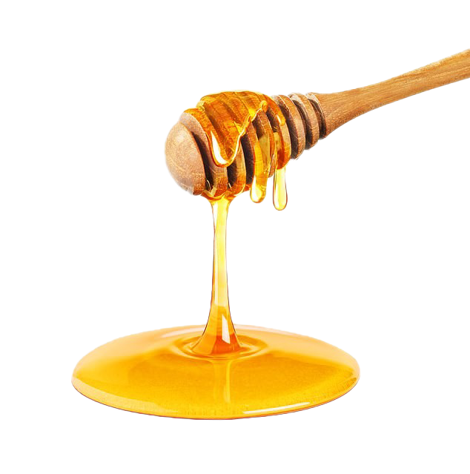
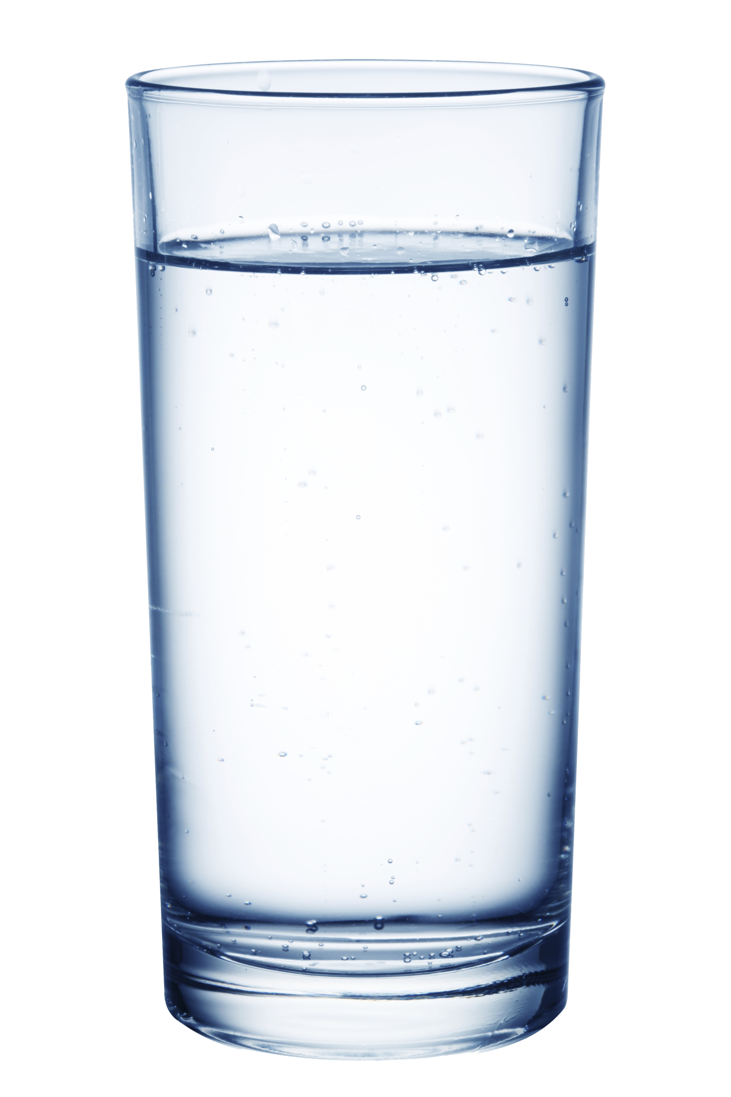
Solids
Do NOT take the shape of their container
Cannot easily be compressed (made more dense)
Are of a fixed volume (the space they take up doesn’t change)

Slide 21
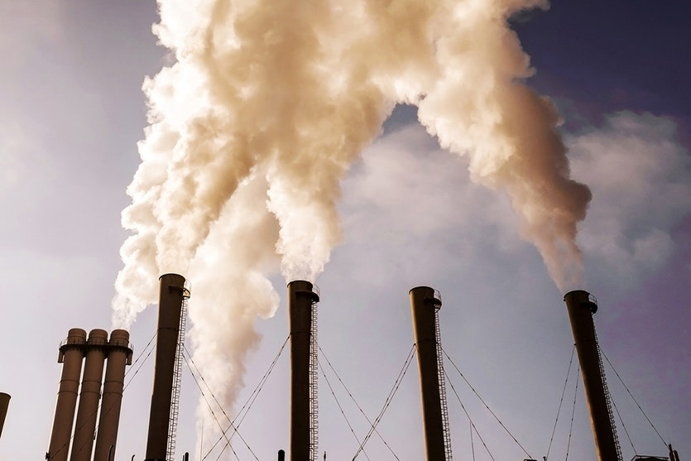
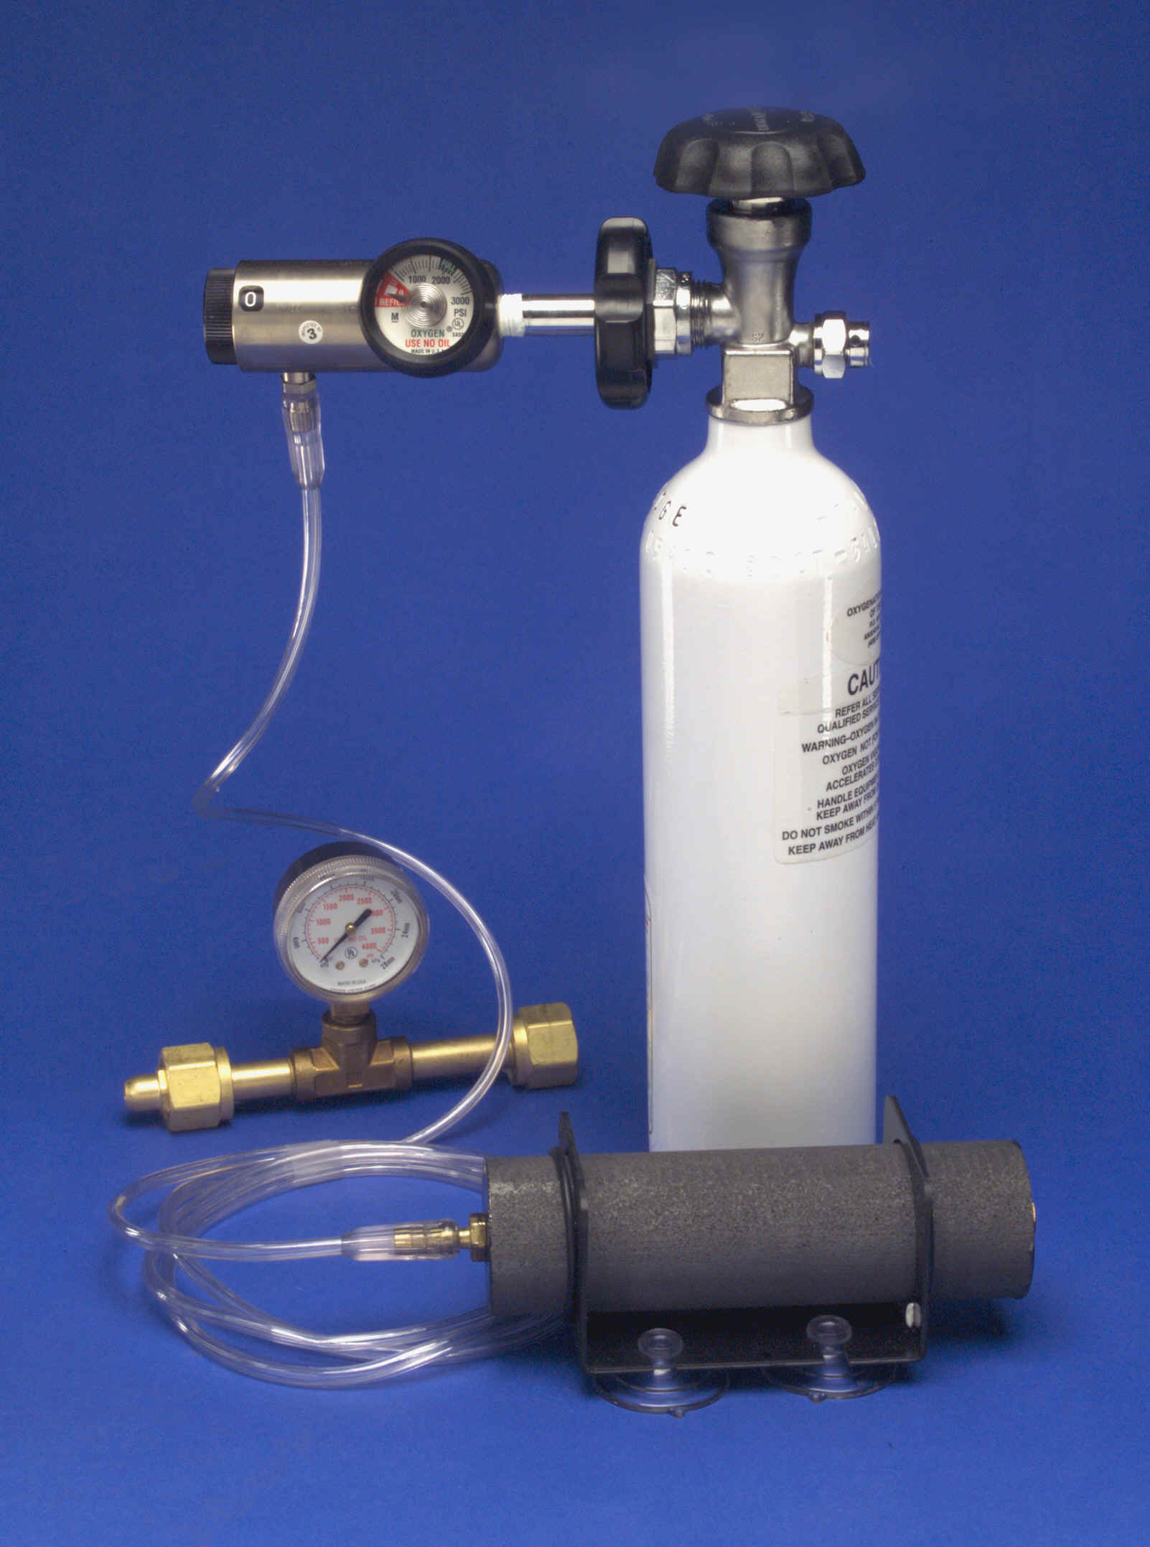

Liquids
Take the shape of their container
Cannot easily be compressed (made more dense)
Are of a fixed volume (the space they take up doesn’t change)

Slide 22
Gases
Take the shape of their container
Can easily be compressed (made more dense)
Are NOT of a fixed volume (the space they take up can change)

Slide 24
Fluids

Slide 25
What are fluids?
Fluids are substances that flow

Slide 26
Water is a fluid

Slide 27
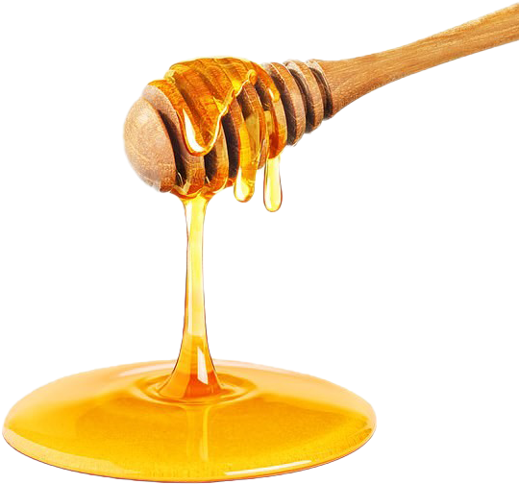
Honey is a fluid

Slide 28
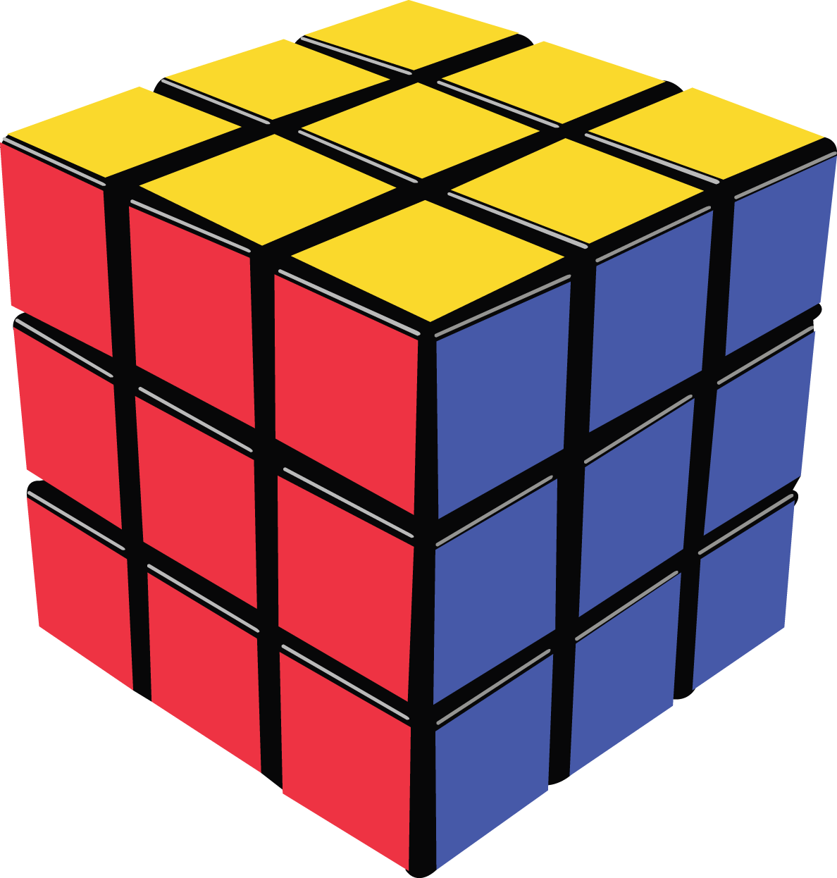
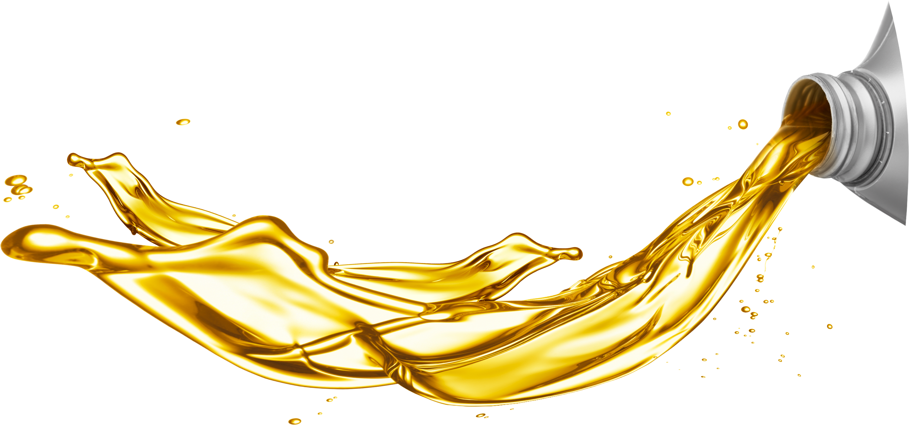
Oil is a fluid

Slide 29
Is a Rubik’s Cube a fluid?

Slide 30
Is a Rubik’s Cube a fluid?
A Rubik’s Cube is NOT a fluid?

Slide 31
Is a rock a fluid?

Slide 32
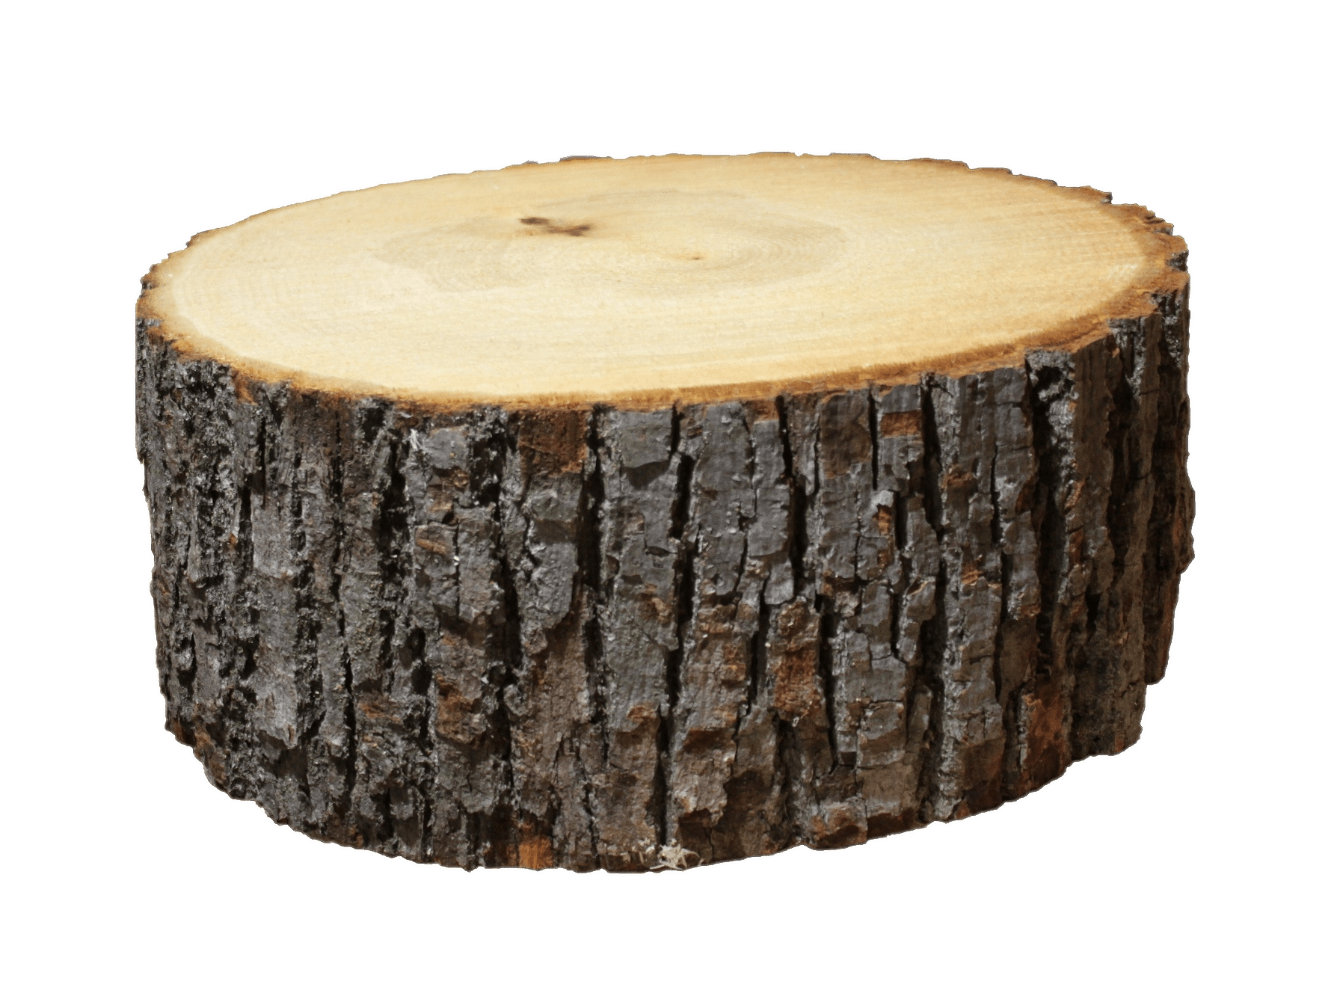
Is a rock a fluid?
A rock is NOT a fluid?

Slide 33
Is a log a fluid?

Slide 34
Is a log a fluid?
A log is NOT a fluid?

Slide 35
Fluids
NOT Fluids

Slide 36
Liquids are fluids

Slide 37
Are gases fluids?

Slide 38
Do gases flow?

Slide 39
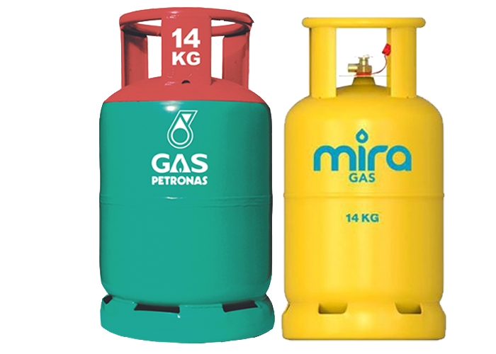
Gases are fluids

Slide 40
Viscosity

Slide 41
What is viscosity?
The viscosity of a fluid refers to its “thickness” or its resistance to flow.

Slide 42
Which has higher viscosity?

Slide 43
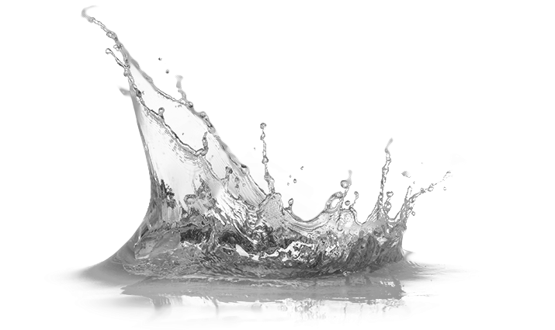
Honey has a higher viscosity

Slide 44
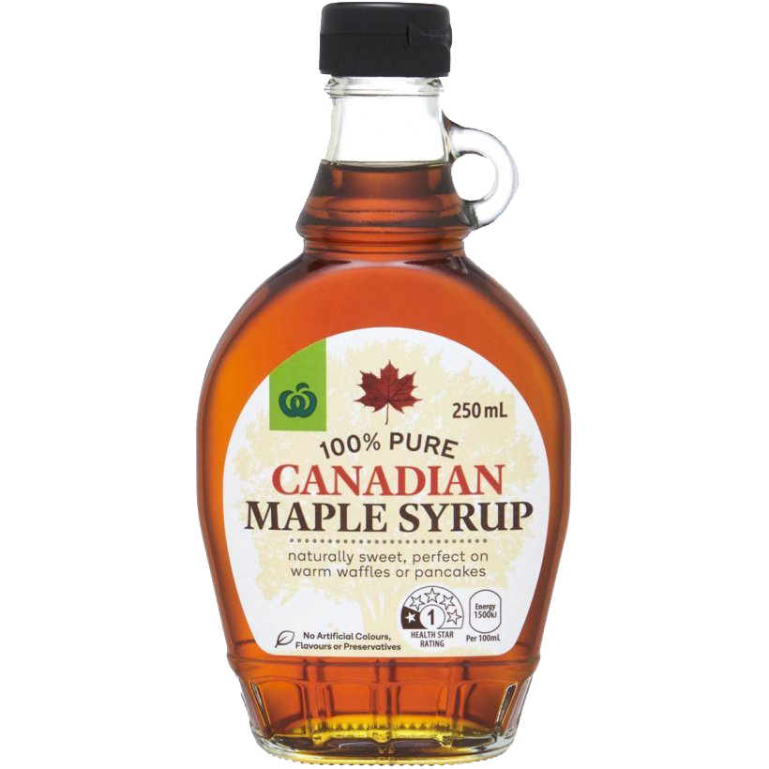
Which has higher viscosity?

Slide 45
Maple Syrup has a higher viscosity

Slide 46
Which has higher viscosity?

Slide 47
Which has higher viscosity?

Slide 48
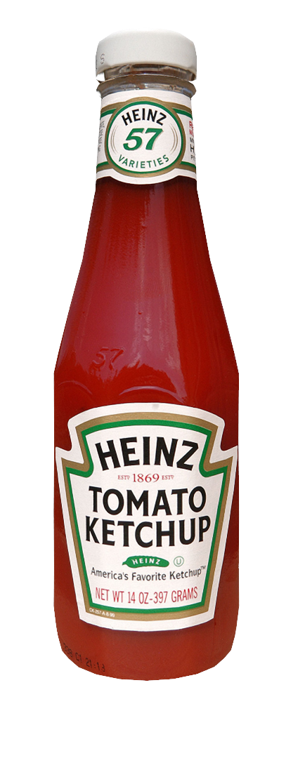
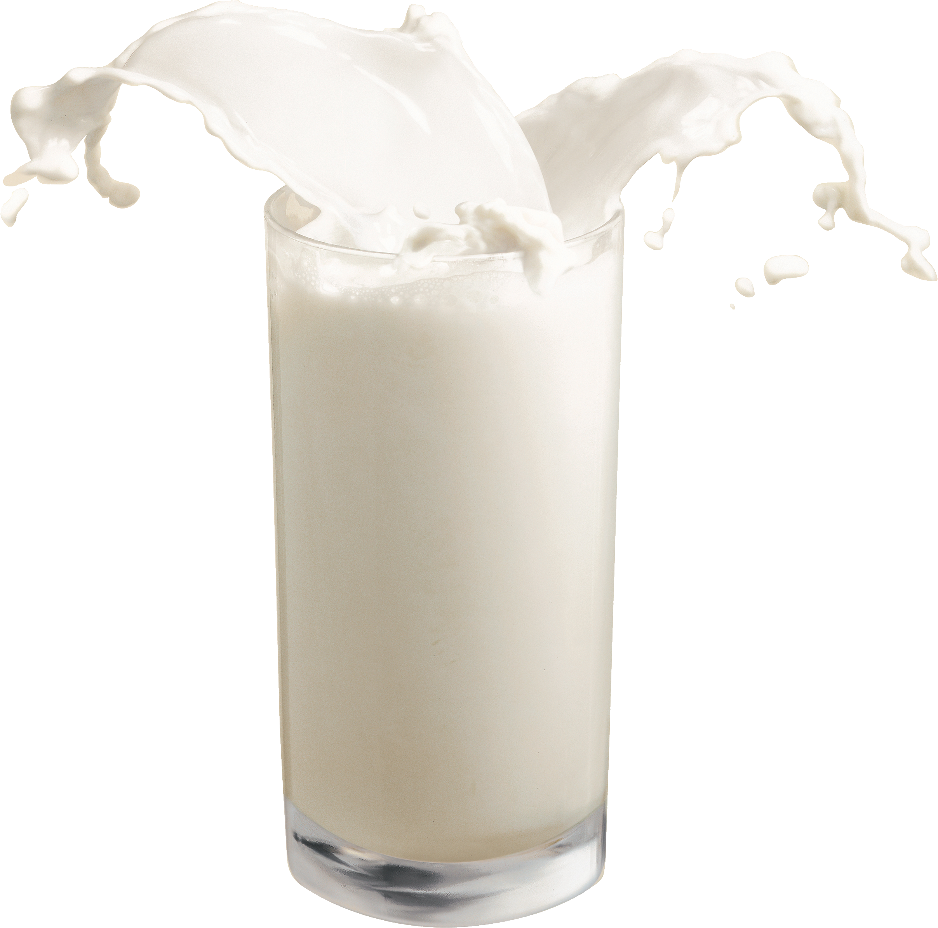
Which has higher viscosity?

Slide 49
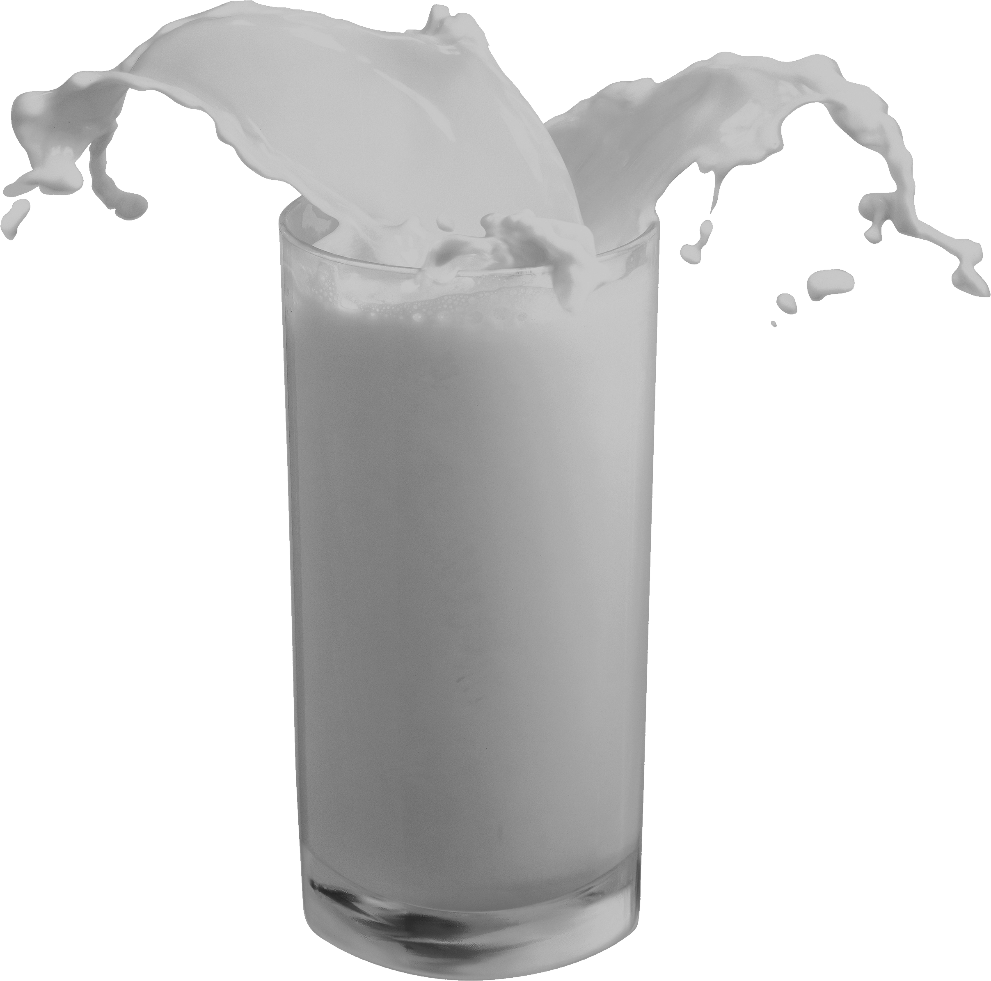
Ketchup has a higher viscosity

Slide 50
Which has higher viscosity?

Slide 51
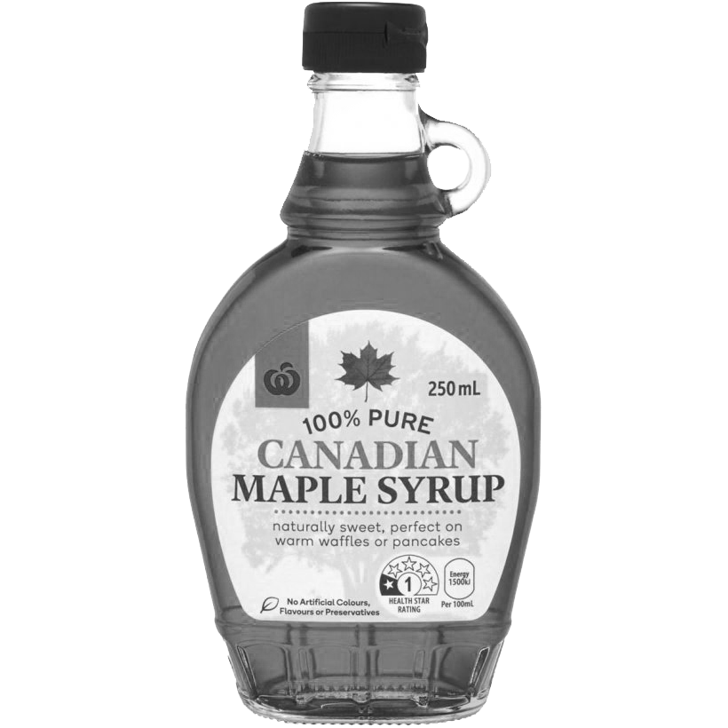
Honey has a higher viscosity (I think)

Slide 52
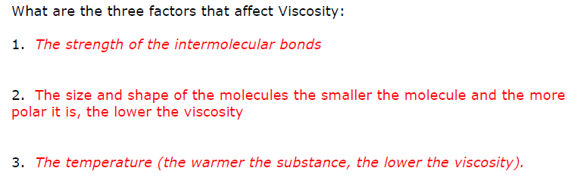
What affects viscosity?

Slide 53
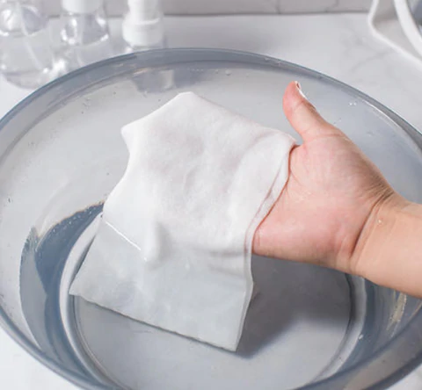
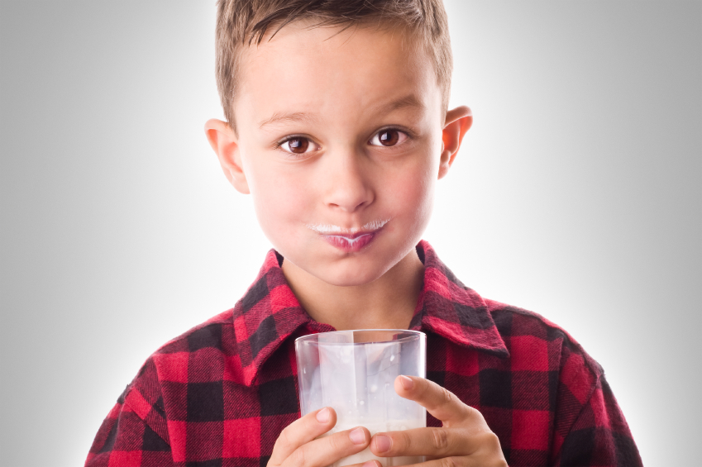
One example of adhesion is water climbing up a paper towel that has been dipped into a glass of water,

Slide 54
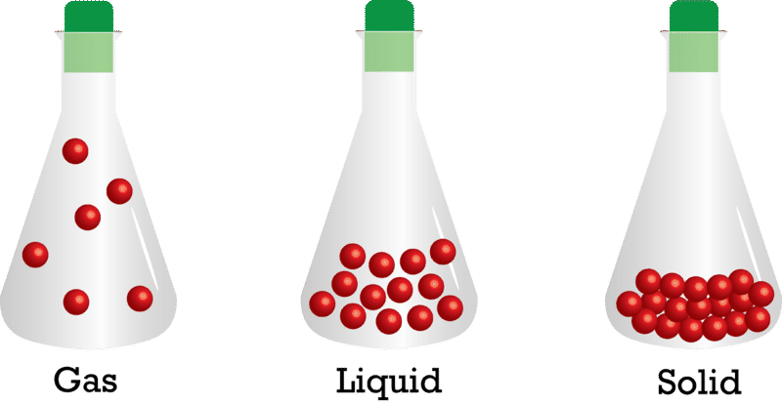

Slide 55
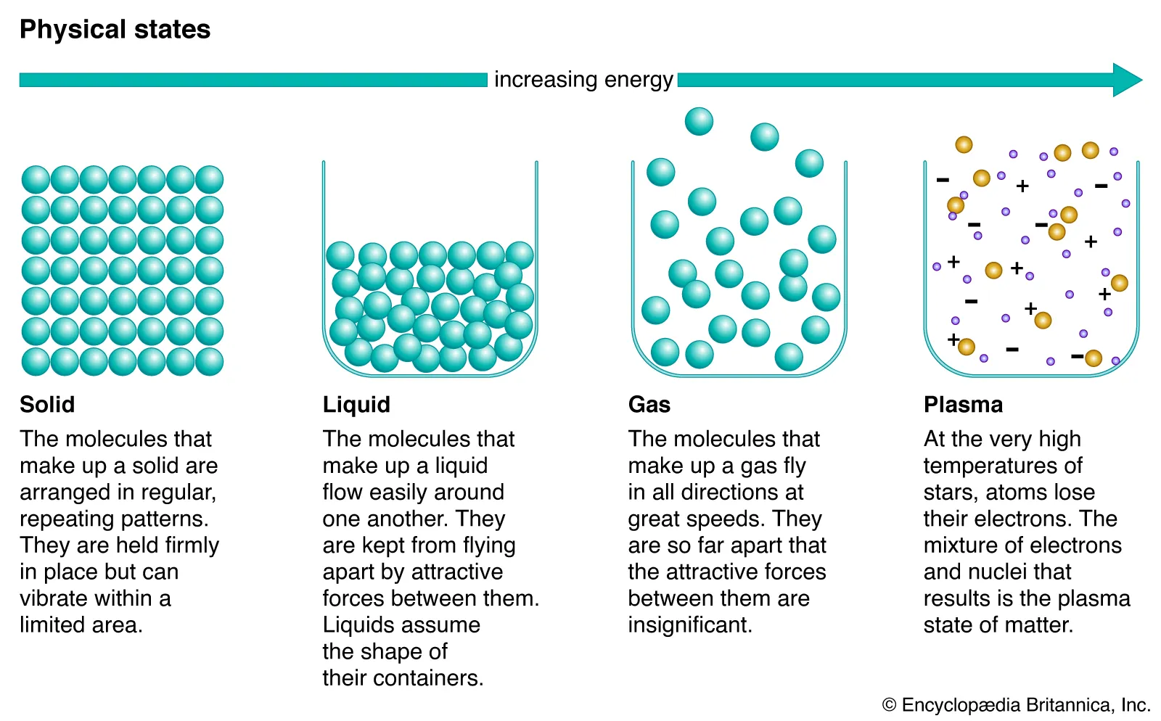

Slide 56
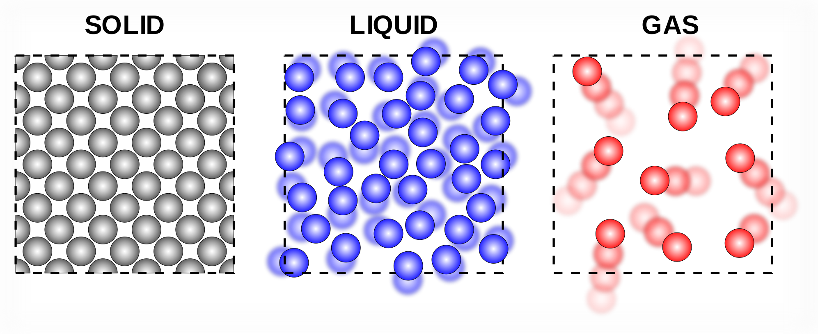

Slide 57
THINGS TO COVER FOR TEST
6 main ideas of particle theory
Physical and Chemical changes/properties
Difference between adhesion / cohesion
What is viscosity
How change viscosity
Density
Archimedes principle
Displacement
Buoyancy
Pascal’s principle
Hydraulic Advantage calculations
Compare/contrast hydraulic/pneumatic systems
Vocabulary

