Slide 1
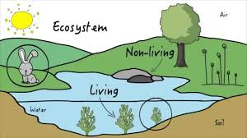
The Ecosystem

Slide 2


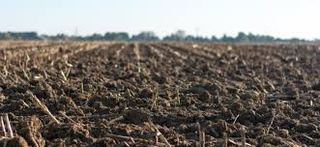
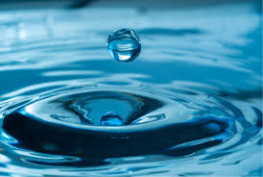
Abiotic means:
not alive
non-living things
LIGHT
AIR
SOIL
WATER

Slide 3
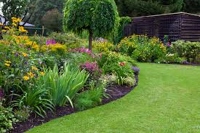
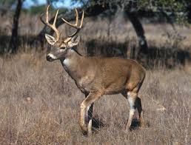

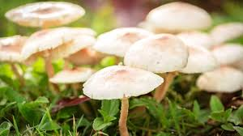
biotic means:
alive
living things
PLANTS
ANIMALS
FUNGUS
PEOPLE

Slide 4
Show what you know...

Slide 5

Abiotic
Biotic

Slide 6
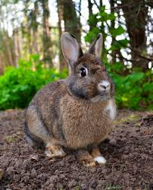
Abiotic
Biotic

Slide 7
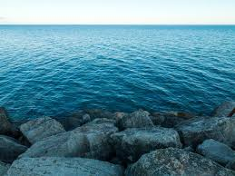
True
False
Water is biotic.

Slide 8
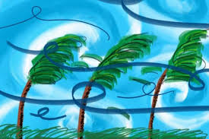
True
False
Wind is ABIOTIC.

Slide 9
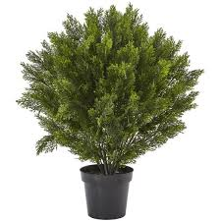
Biotic
Abiotic
A plant is _________.

Slide 10
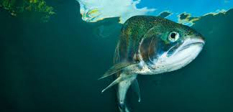
Agree
Disagree
A fish is ABIOTIC.

Slide 11
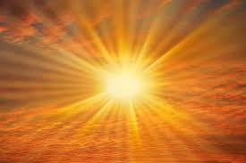
Abiotic
Biotic

Slide 12
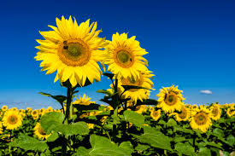
Abiotic
Biotic

Slide 13
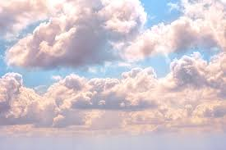
Agree
Disagree
A cloud is ABIOTIC.

Slide 14
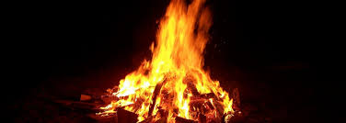
True
False
A fire is biotic.

Slide 15
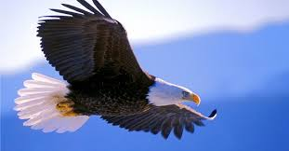
Abiotic
Biotic
An eagle is ______.

Slide 16
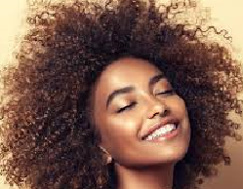
Abiotic
Biotic
Hair is ______.

