Slide 1
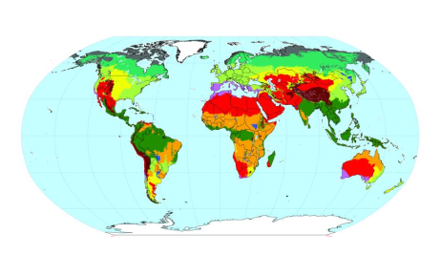
Biomes of North America
Research by 7-#

Slide 2
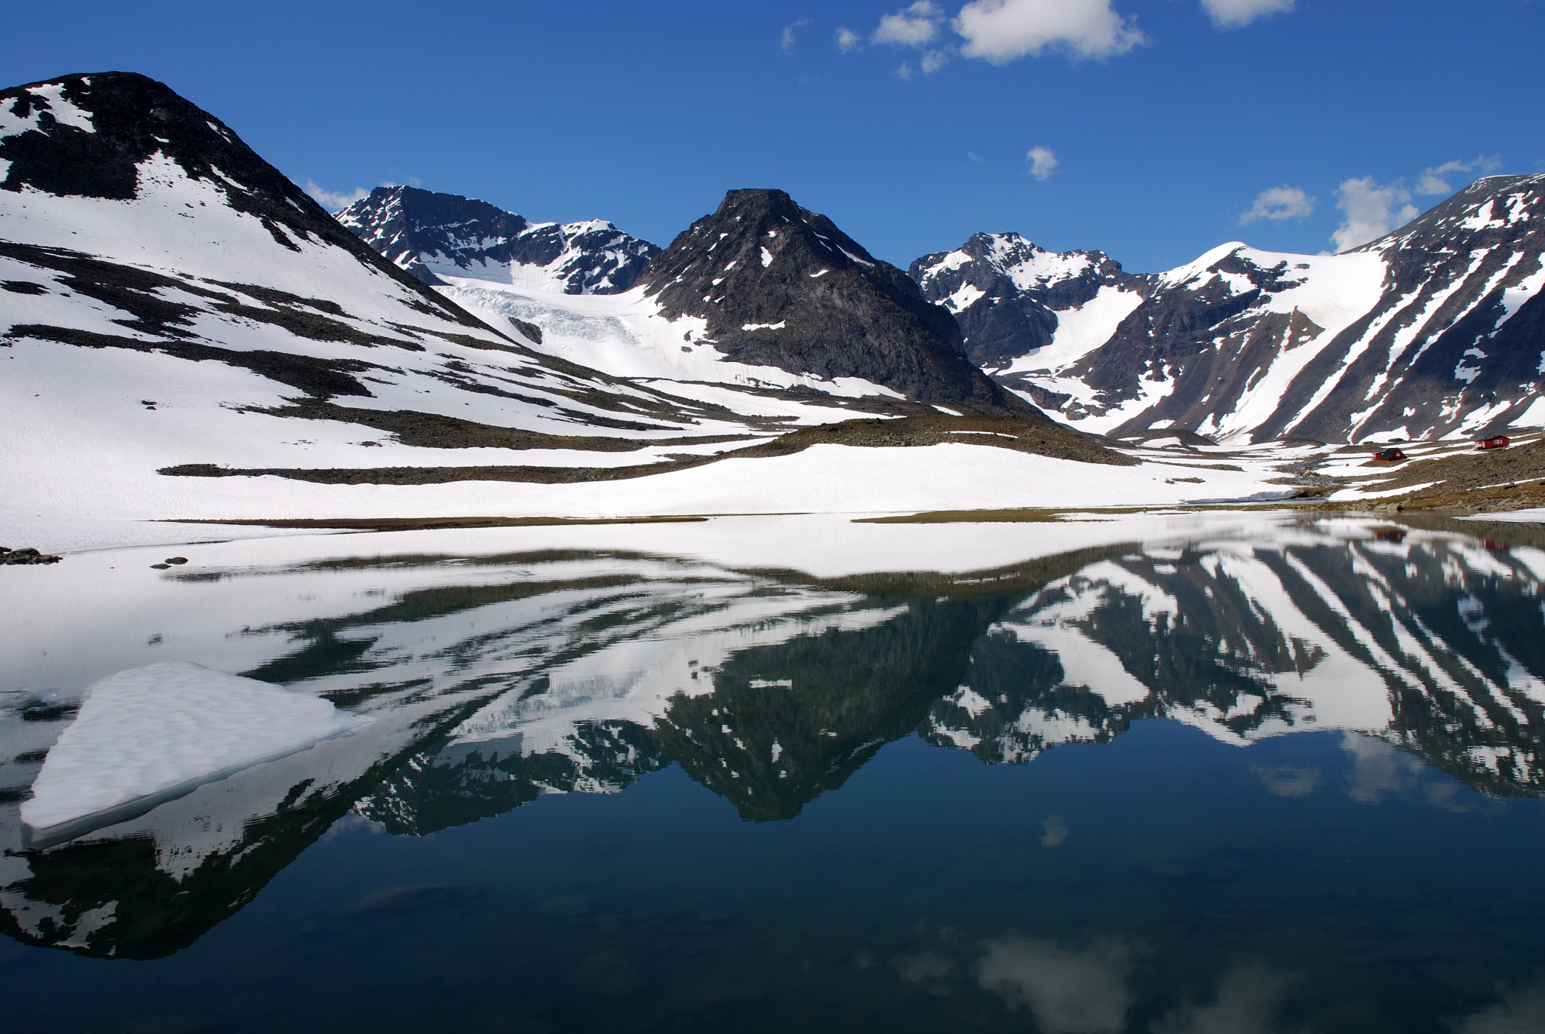
Tundra
Appearance: Lots of water, snow, and mountains, no trees.
Climate:Tundras are among Earth's coldest places. In winter the temperature can get to -35 degrees Celsius in winter. In summer the high is 10 degrees Celsius. Precipitation: Rains most in April, June, August
Organisms: Animals: Polar Bears, Wolves, and Arctic Foxes. Plants: Shrubs, Grass, and Moss
Location: Northern arctic, the top of the world
Interesting Facts:In the North Pole’s Summer, the sun stays in the sky all day long. In the winter, it is completely dark. The Northern Arctic Ecozone is sometimes referred as an Arctic Desert because of its dry climate and lack of precipitation.

Slide 3
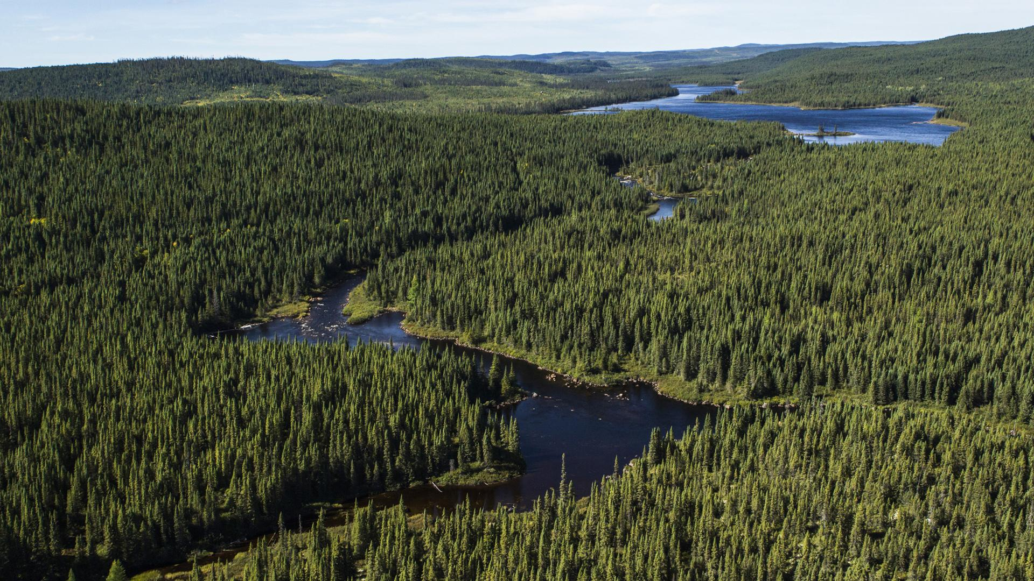
Boreal Forest (Taiga)
Insert a picture in this corner. Delete this font.
Appearance:very green, a lot of trees, and has many lakes
Climate:For most of the year taiga is dark, cold, covered in snow and ice but can also be very green most of the year.
Organisms:The many organisms they have in the Boreal forest are: caribou, wolves, bears, coniferous trees, mosses, and paper birch.
Location: Taiga stretches over Eurasia and North America. The Taiga is located on the top of the world, just below the tundra biome.
Interesting Facts: Taiga is the largest biome in the world, it is also the Russian word for forest.

Slide 4
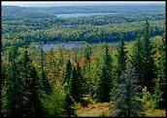
Temperate Forest
Insert a picture in this corner. Delete this font.
Appearance:A different variety of coloured trees, depending on
the season. Also you would see lots of rivers and lakes.
Climate: The amount of precipitation per year is 750 to 1500 inches. The average temperature is 10 degrees celsius. Hot summers and cold winters.
Organisms:Foxes, Spotted Owls and Squirrels. 3 types of plants found here are Ferns, Trilliums and the Ghost Orchid.
Location: The location is the heart of Asia to Central China. Mid latitude and coastal appearances.
Interesting Facts: The first fact of the temperate forest is that fungi feed on dead/rotting wood. The second fact is the antarctica used to be a temperate forest, until it drifted to far south it froze solid.

Slide 5
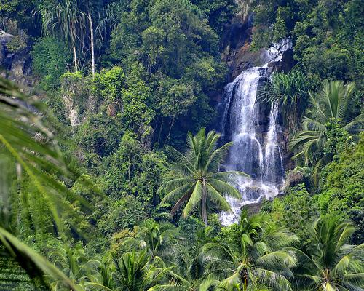
Tropical Rain Forest
Appearance:
Is very humid because of all the rainfall. A tropical rainforest gets about 150 cm of rain per year.
Climate:The tropical rainforest is a hot and moist biome found near Earth's equator.
Organisms:
Some of the organisms in a rainforest are, insects, birds, reptiles, amphibians and mammals.
Location:Tropical rainforests are located near the equator. 57% of all tropical rainforests are found in Latin America. One third of the world's tropical rainforests are in Brazil.
Interesting Facts:The world's largest tropical rainforests are in South America Africa, and Southeast Asia. Tropical rainforests receive from 60 to 160 inches of precipitation that is fairly evenly distributed throughout the year.

Slide 6
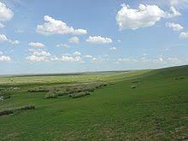
Grassland
Appearance:Grasslands can come in many shapes and sizes, they can range from dry savannas to rich watery marshes
Climate:Grasslands have hot summers and cold winters in summer it can get up to 37 degrees celsius and in winter it gets down to -40 degrees celsius. There are 25-50 cm of rain a year
Organisms: Animals: Moles,Rabbits,Burrowing Owls. Plants: needlegrass, white oaks and foxtails and much more.
Location:grasslands are all over North America, and can survive in temperatures 15 to 40 degrees celsius
Interesting Facts:Grasslands kills trees but not grass,there are lots of fires
in grasslands

Slide 7
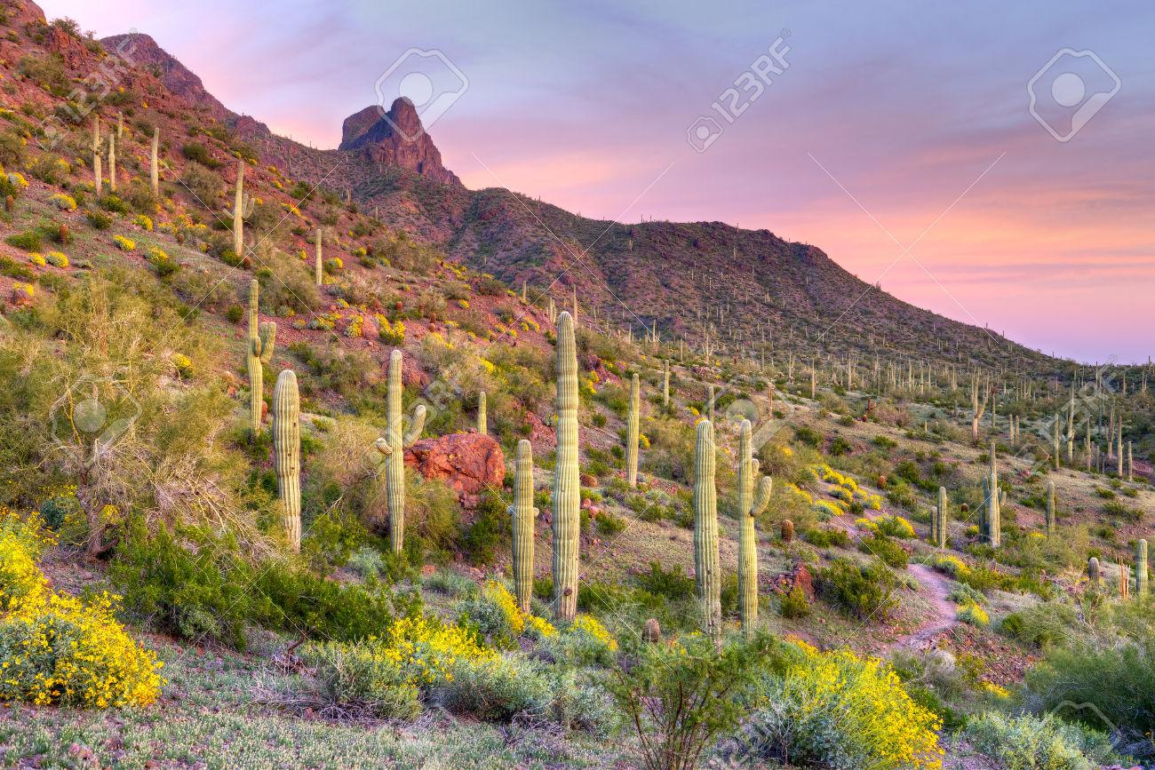
Desert
Insert a picture in this corner. Delete this font.
Appearance:Lots of sand, plants and rocks
Climate:The desert gets its water from melting snow off mountain tops and less than ten inches of water a year. In summer, temperatures go over 100 degrees celsius and in winter becomes colder around 80 degrees because of snow on the mountains
Organisms:3 types of animals found in the Desert are snakes, coyotes and scorpions and 3 plants found are cacti, quiver trees and yuccas
Location:Closer to the equator in the more of the south area
Interesting Facts:The day time temperatures are very hot but at night it gets colder.Some deserts are so hot that when it rains the water evaporates in the air before hitting the ground.

Slide 8
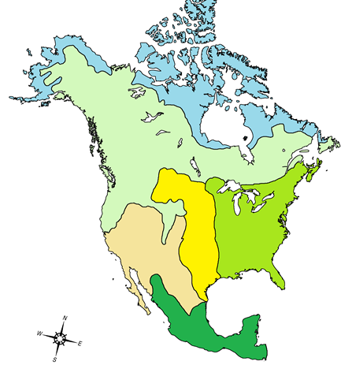
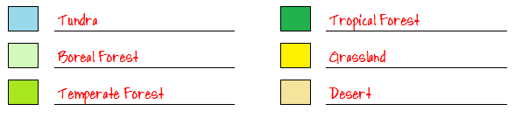
Biomes of North America
Here is the map for your homework. Be sure you complete both the map and the legend.
As well, for homework, you need to complete the information table, including info for all 24 boxes. That information should be in the slides prepared by your peers.
This information will appear on an upcoming quiz.

