Slide 1
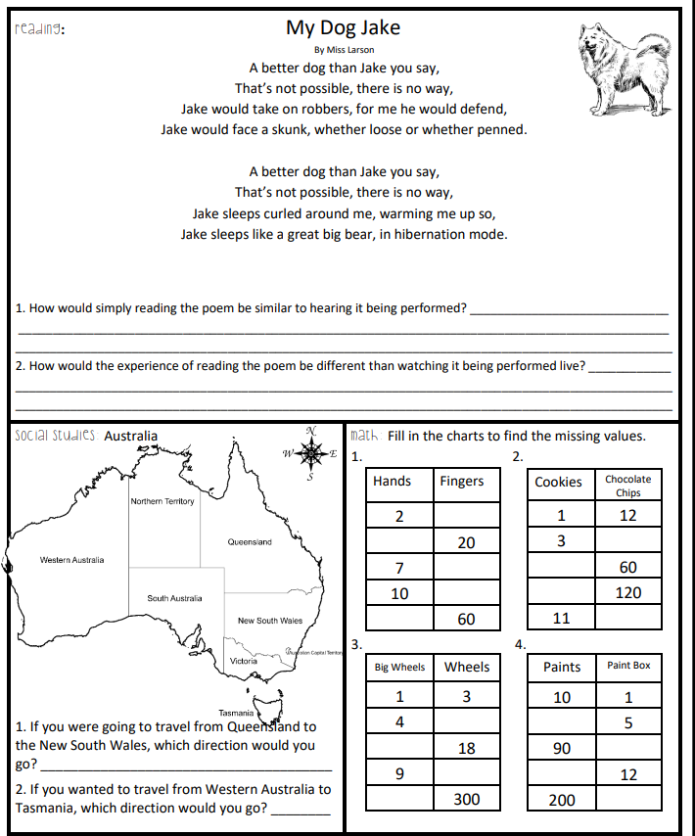
Bellwork – Jan 15 to Jan 19
Name:___________________

Slide 2
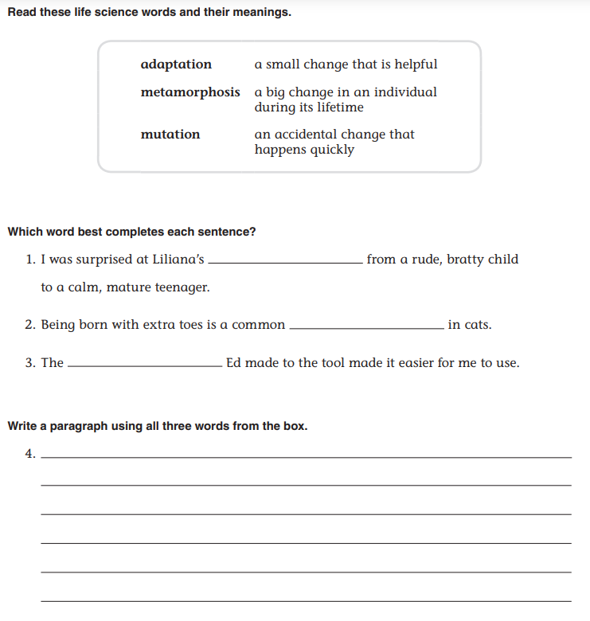
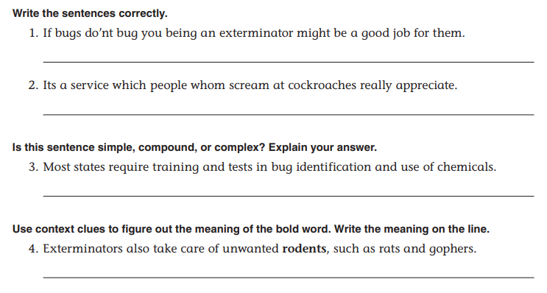
Language Review

Slide 3
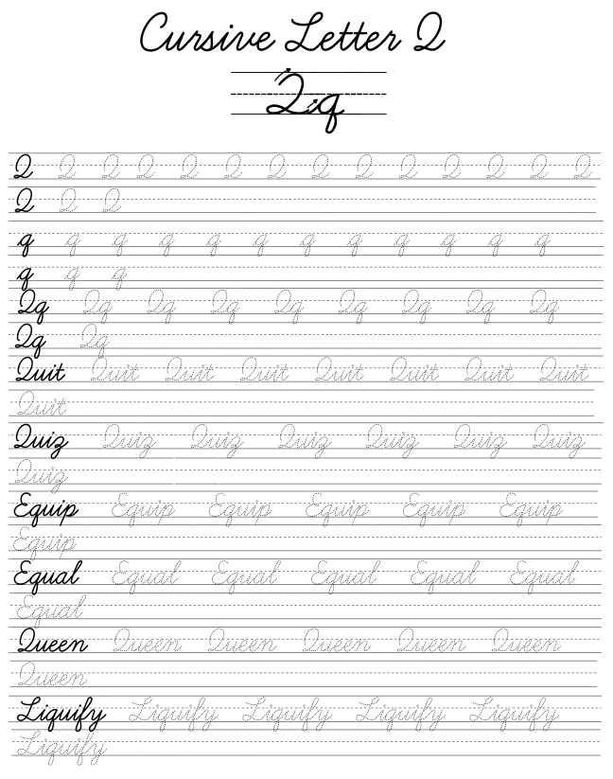
*COMPLETE ALL LINES, especially those left blank.

Slide 4
