Slide 1

Stress Lesson #2
Stressed or Not Stressed???

Slide 2
Learning Goal
I am learning the kinds of situations and events that trigger stress responses, and can think of ways to cope with these stressors.

Slide 3
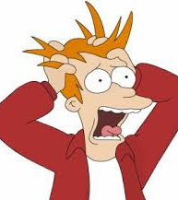
Vocabulary
Stress- anything that threatens us, challenges us, scares us, worries us or thrills us.
Stressor- the activity that creates stress
Cope- an activity that you complete to releive stress.

Slide 4
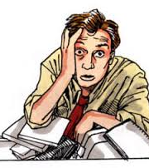
What you need to know about Stress?
Stress can be real or imagined, healthy or unhealthy
What stresses people out is different from one person to the next
Some stress in our lives is necessary to feel alert and energized and helps us perform better.

Slide 5
Stress Symptoms
Butterfly feelings in your stomach if your excited
Feeling tense, fidgety, like you need to use the toilet a lot
Feeling of nervous, and worry
Feeling pressured, hassled, and hurried
feeling irritable and moody
Having trouble sleeping
Felt sad or depressed

Slide 6
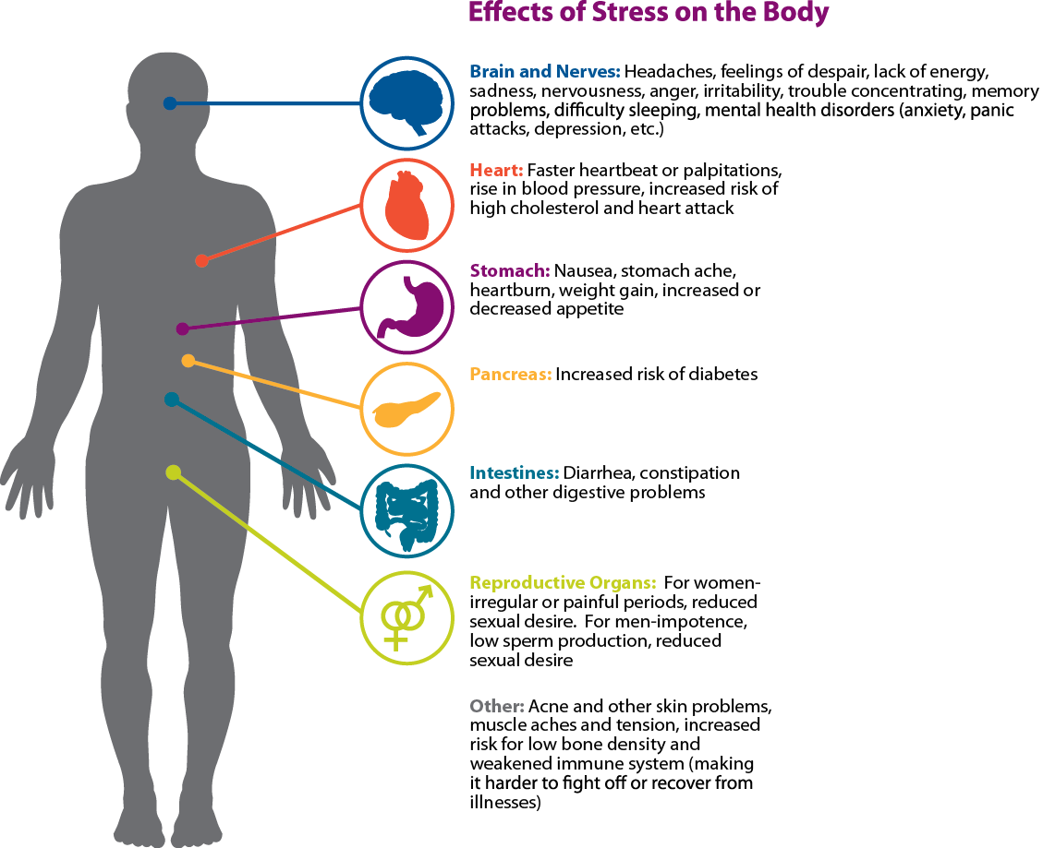

Slide 7
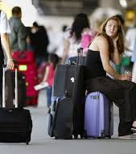
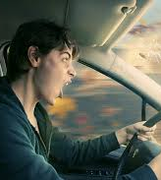
What is the stressor?

Slide 8
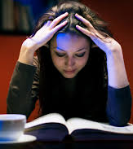
Stressor?

Slide 9
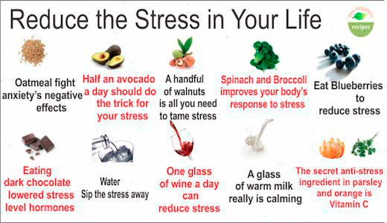
Foods that can reduce Stress!!

Slide 10
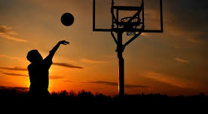
Activities to reduce stress

Slide 11
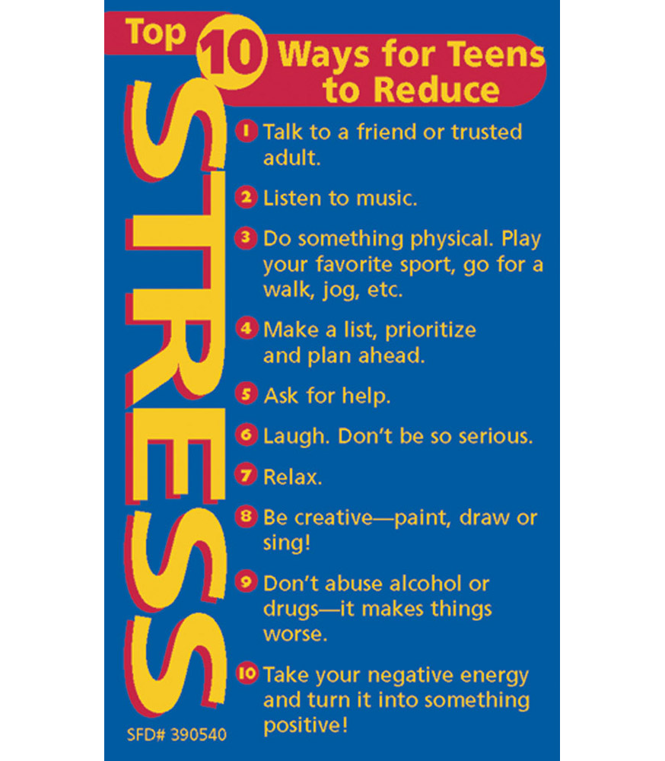
Stress No More!!!

Slide 12
Teen Brain
I am learning how stress affects all people’s brains
I am learning the 3 key parts of the brain that play a role in how we react to stress

Slide 13
How stress affects your Brain
https://www.youtube.com/watch?v=gmwiJ6ghLIM
Amygdala
Hippocampus
Prefrontal cortex

Slide 14
Coping with it- Stress Lesson #4
Re- read through you handout about the teen brain from last week. Be prepared to discuss the roles of
The amygdala in stress response (fight or flight)
The role of the prefrontal cortex in processing sensory imput
The role of the Hippocampus

Slide 15
Stress Management Detective
You will have 5 minutes to discuss to with your partner the 4 areas of stress Management. Do your best to fill in each box with atleast 3 examples.

Slide 16
Reflection
What does stress mean to you?
What comes to your mind when you think of stress?
How does stress make you feel? How do you know when you are stressed?
What kind of things stress you out?
Consider the positive side of stress and recall occassions when the stress you were under worked to your advantage?

Slide 17
Lesson # 3 Coping with it!
Research shows that 10 minute daily stress management intervention can decrease feeling of anxiety an improve the ability to relax and learn.
Research shows that when we change our physical state, through movement, relaxation or mindfulness we can change our emotional state.

Slide 18
Mindfulness
https://www.youtube.com/watch?v=awo8jUxIm0c

Slide 19
Ways to take care of ourselves
Maintain good mental and physical health through a healthy diet, exercise and sleep

Slide 20
Strategies for calming ourselves Down
Stretching
Breathing
Mindfulness
Not jumping to conclusions
Helpful self talk
Listening to music/dance
Be positive

Slide 21
Problem solving to reduce stress
Seeing problems as “things that can be solved”
Problem solving is just a series of steps which include.
1 Identifying the issue/problem
2. Going through the problem solving process
3. Reviewing and Assessing whether it works

Slide 22
How to deal with unavoidable stress
Adaptive strategies like breathing, creative visualization

