Slide 1
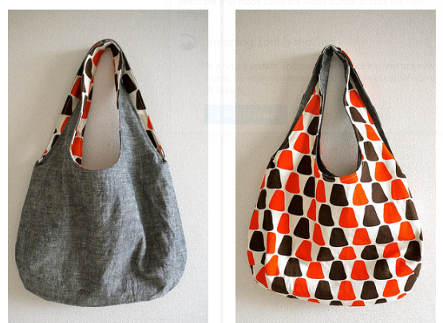
Reversible Bag
Sewing Project

Slide 2
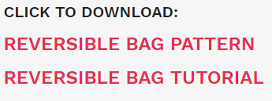
Step 1:
Download Pattern
There is a free pattern for this bag at the following link:
http://verypurpleperson.com/2010/04/making-reversible-bag/
Scroll to the bottom of the blog to download the pattern and instructions.

Slide 3
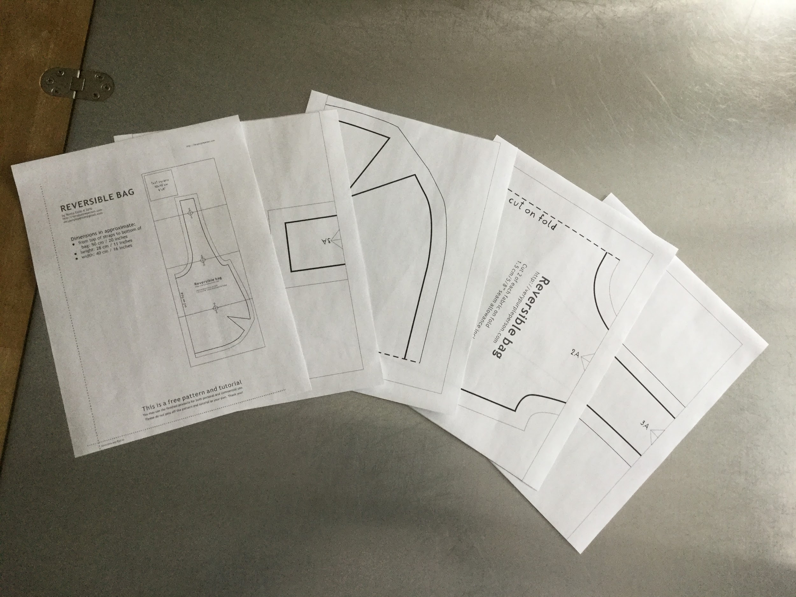
Step 2:
Print Pattern
You should have 5
printed pattern pages.
Make sure you print
the PDF files so the
sample square
measurement is correct

Slide 4
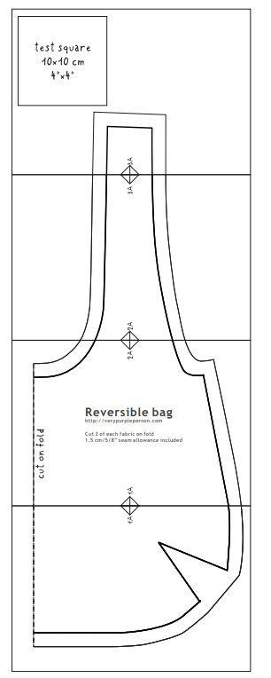
Step 3:
Tape Pattern and Cut
Trim and align pattern pieces, then secure with tape.
Again, make certain your test square is 4” x 4”
Cut outside line around pattern piece.

Slide 5
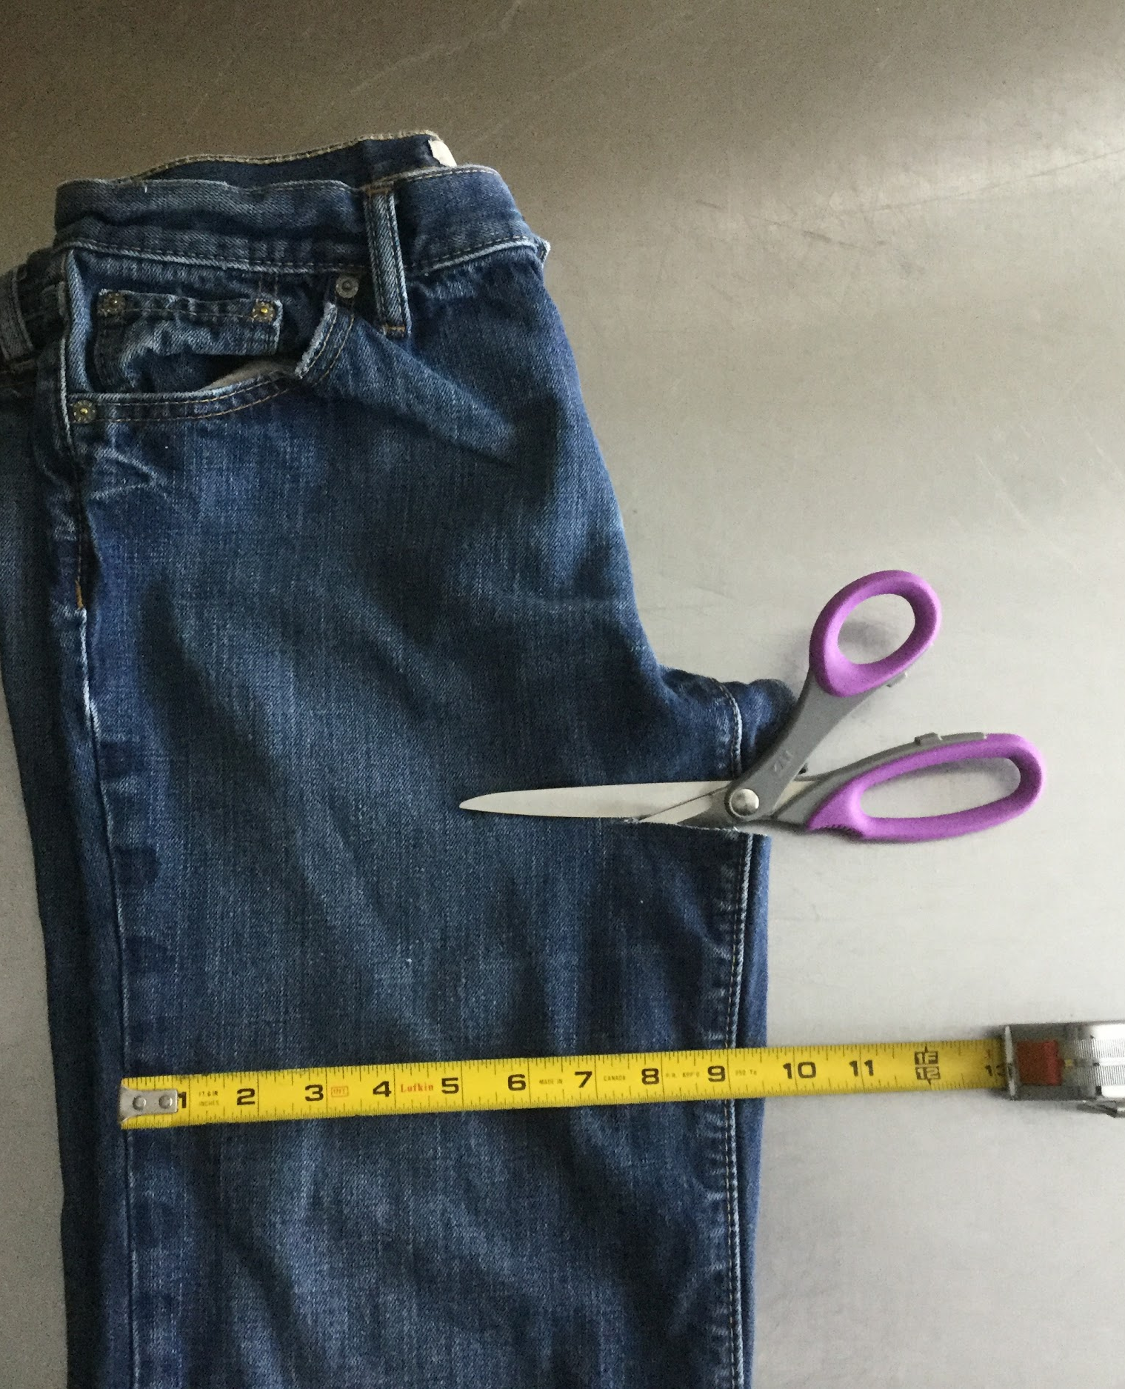
Step 4:
Prepare Denim Fabric
Make sure your jeans are long enough
to fit the pattern piece and make sure they are at least 9 inches wide.
Cut the jeans around the crotch area to prepare you fabric for cutting.

Slide 6
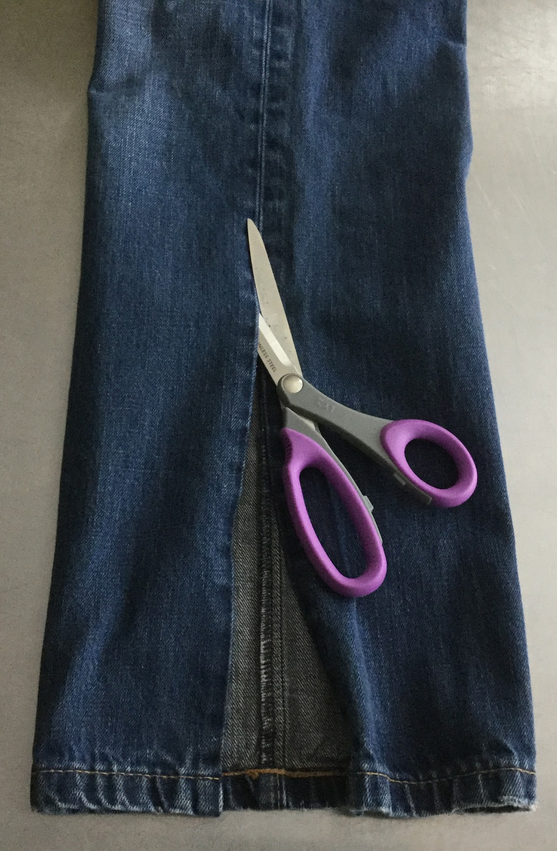
Step 5:
Prepare Denim Fabric -2
On the inside seam, cut and fold fabric at outside seam (seam with top stitching).

Slide 7
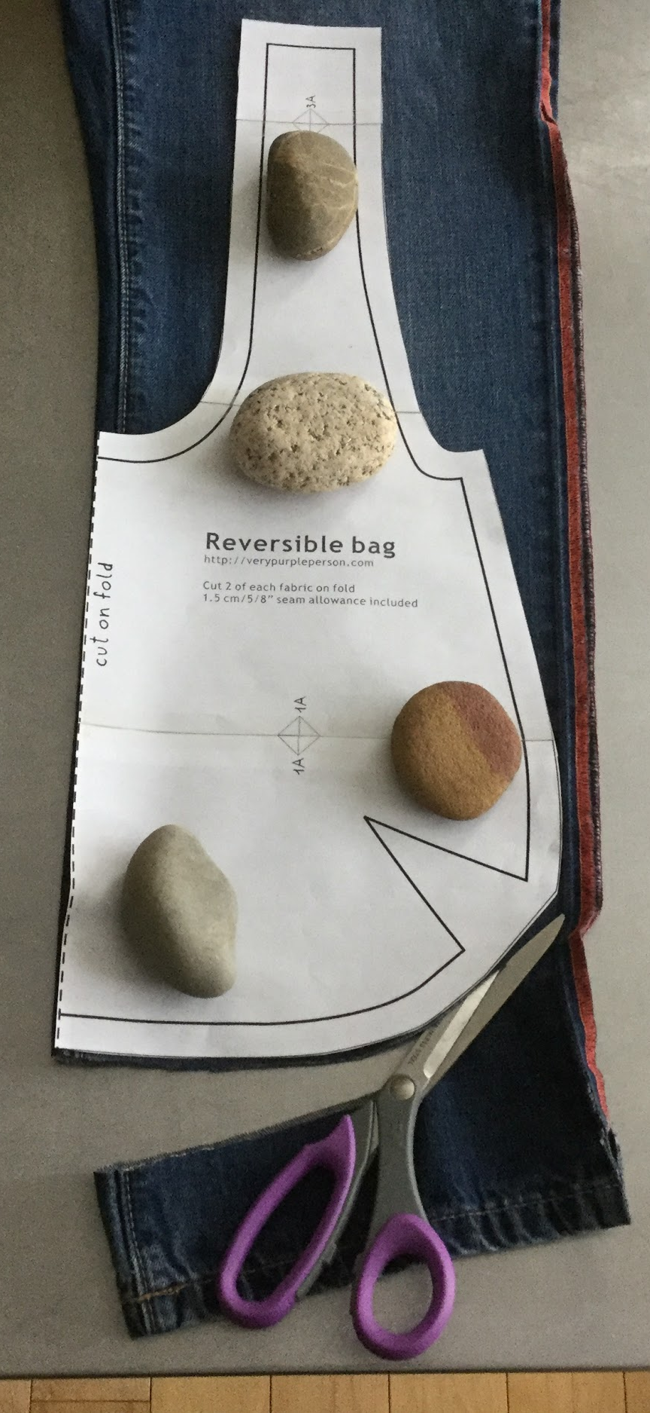
Step 6:
Place Pattern on Fold and Cut
IMPORTANT: Make sure you place the pattern on the folder edge of the denim where the pattern piece reads, “place on fold”.
Pin or secure the pattern piece and cut.
DO THIS TWICE one for each leg.

Slide 8
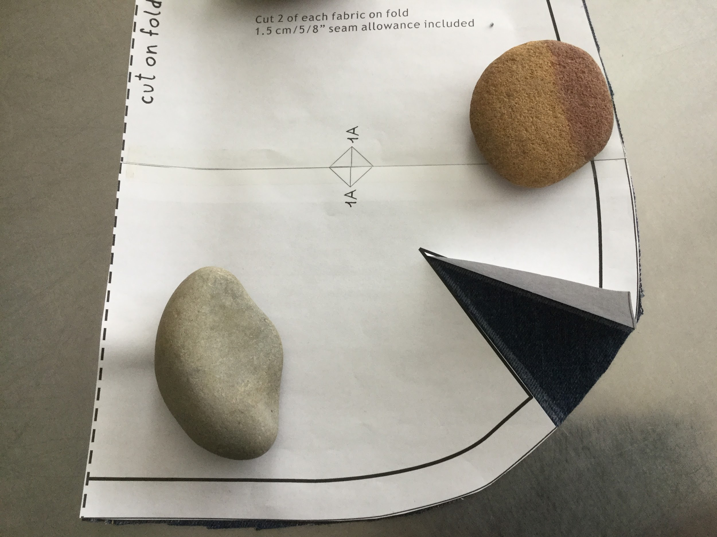
Step 7:
Mark Dart
With chalk make the dart on the inside of both pieces, you should make 4 markings.

Slide 9
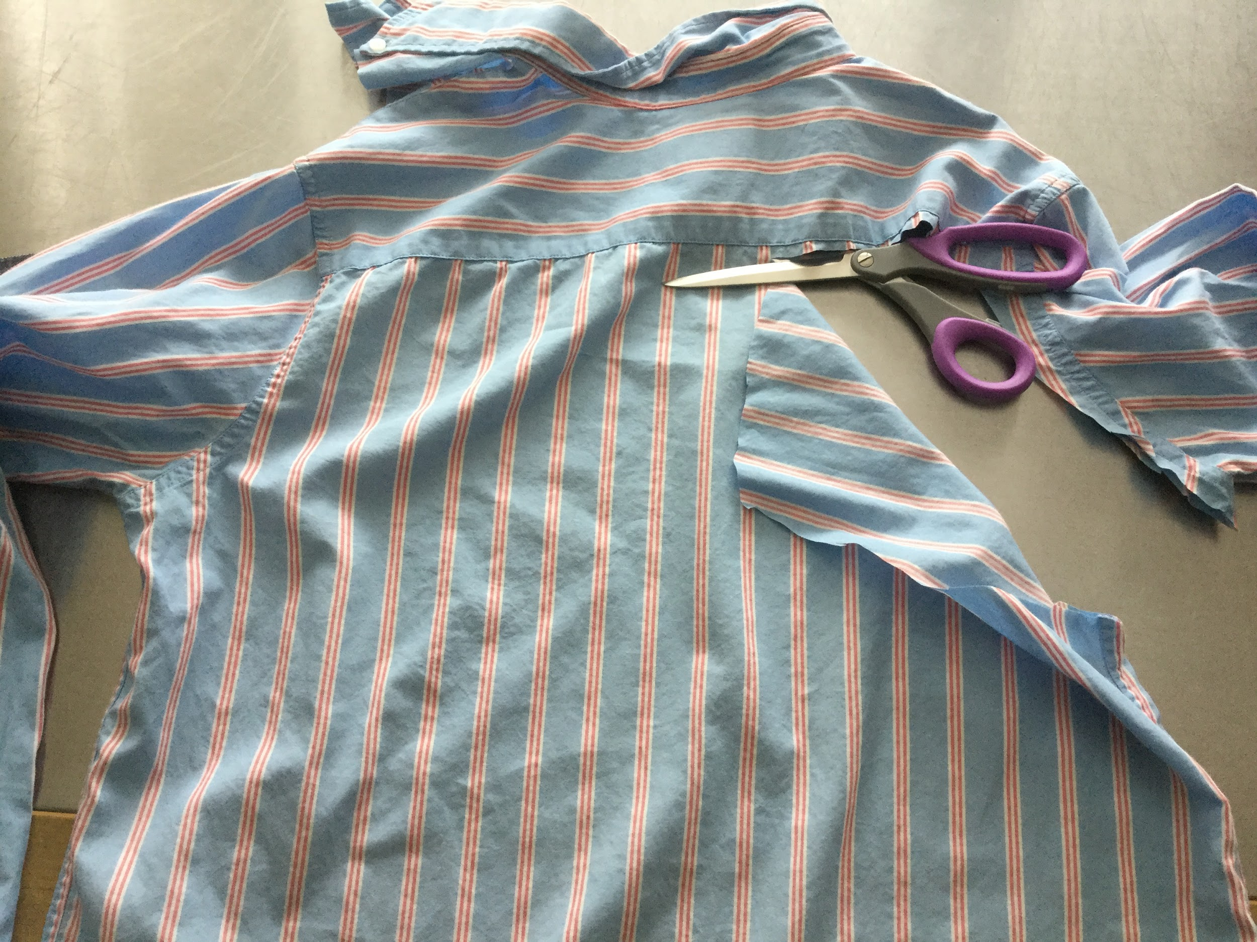
Step 8:
Cut other fabric
If you are upcycling a shirt cut out the shirt and place the pattern piece on the fold for both the front and back of the shirt.
Make sure you mark the darts as well.

Slide 10
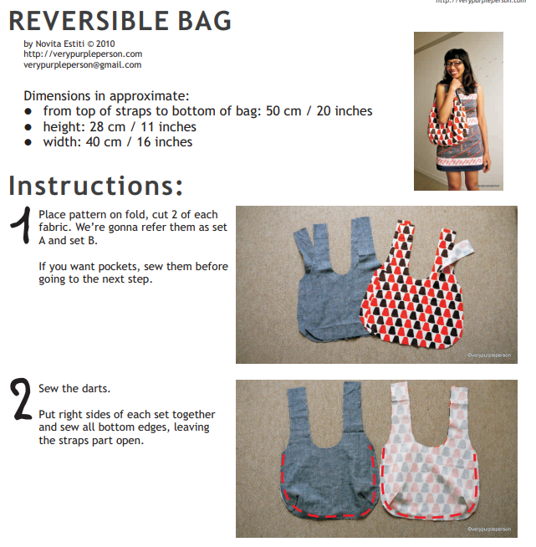
Step 9:
Begin Following
Tutorial Instructions
Following downloaded tutorial instructions and begin constructing the bag.

Slide 11
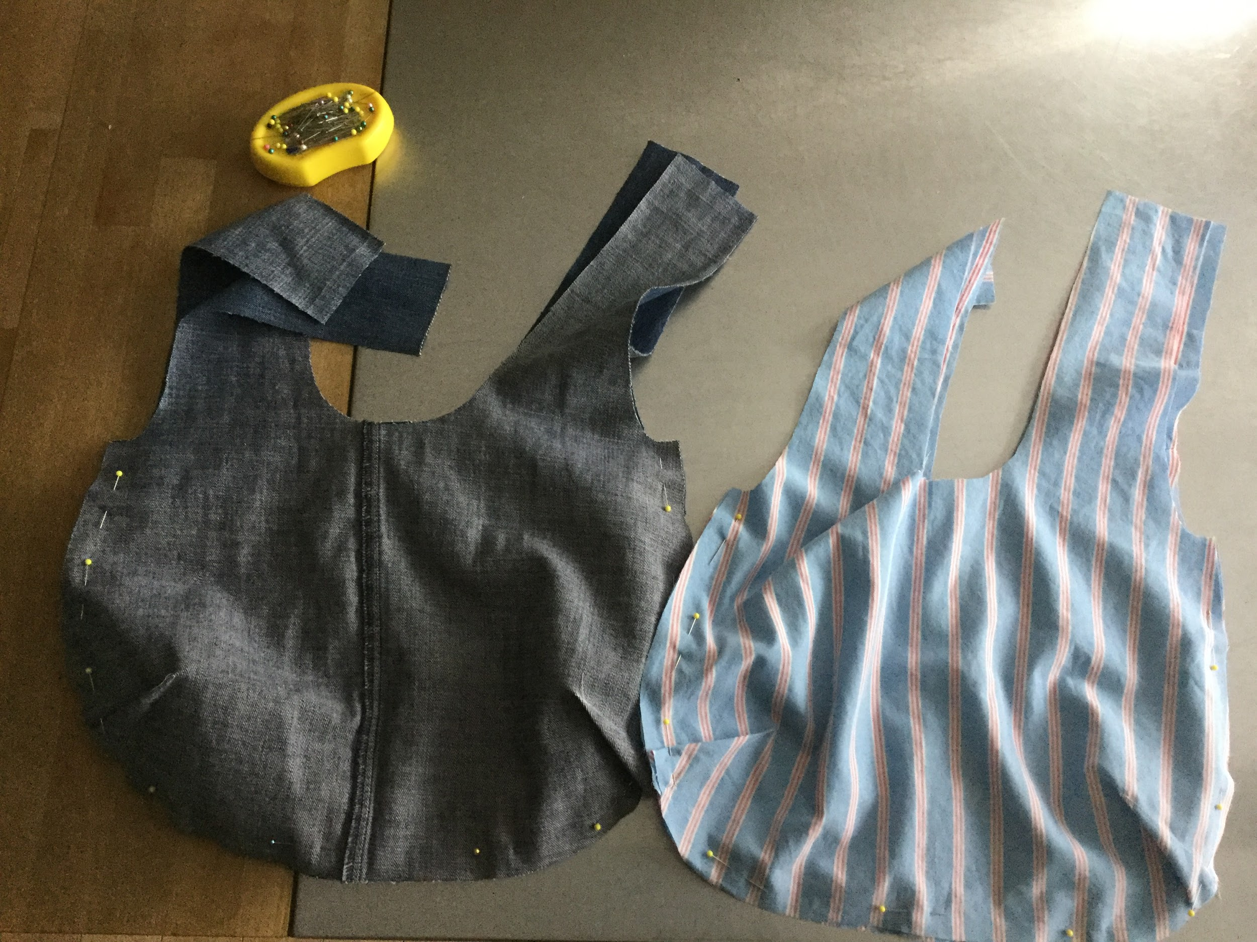
Step 10:
Set A and B
At step 3 of the tutorial you should have a Set A and B

Slide 12
Final Product
Once you get to step 10 in the tutorial your final bag should be complete! DONE

